Slide 1
ScreeN SHOT REVIEW
02/17/2026

Slide 2
Code Review Plan – From Wireframes
After a Rapid Development Cycle in both HTML and React we have identified the following pages:
There are 26 Main Pages related to this application…at the present... Debating 2 more… time permitting related to userprofiles/corporateprofiles which are very difficult pages.
The instructor said login/logout don’t count although they are in fact very important pages for user specific information. We have net 24 now which is 5X more than required.
There are three more areas of corporate information in modal forms

Slide 3
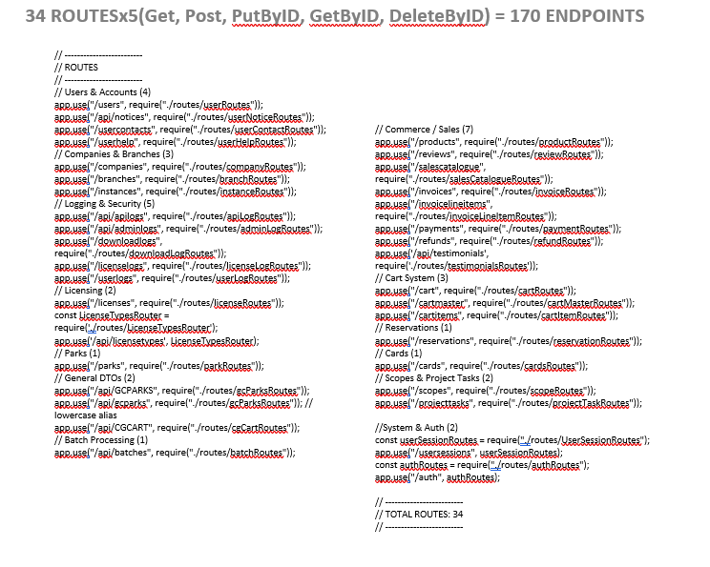
Backoffice review FOR JS/HTML Pages
api242.onrender.com -> 34 Tables as of Today….
Tables are variants of a schema built on C# for CSCE547.
Although the port is non-trivial from C# to Express.
We added several new tables for Customer Reviews, Products, Testimonials, and Invoicing as the previous cart was built for date specific sales types. (ticketing), and not for MRC/NRC sales.
We had to rebuild the cart model and that requires Invoice tables.
We decided to collapse user/userprofile and rebuild the usermodel from previous so this is an all new SSO.
We ported an encrypted auth controller from C# to Express which took more than a week.

Slide 4
General Layout of screens…..
(1) Header Nav & Mobile Menus using Material UI in Header Spaces.
On Previous JSS Development Tools we added UserProfile Links for Account Management.
We are debating it for this application.
(2) A Topsection Page set up with two subsections:
A Data Grid (SS1)
A Features Bar (SS2)
It is possible for some screens either SS1, or SS2 might not be there.
(3) A Bottom Section which is designed to Fill Space in Excess of 800PX.
It has Quick Links, A Site Map Table, and Two Pictures in a 3 Column Layout.
On Mobile these are stacked to provide 1500px of fill.
(4) Bottom Nav & Mobile Icons using Material UI in Footer Spaces.

Slide 5
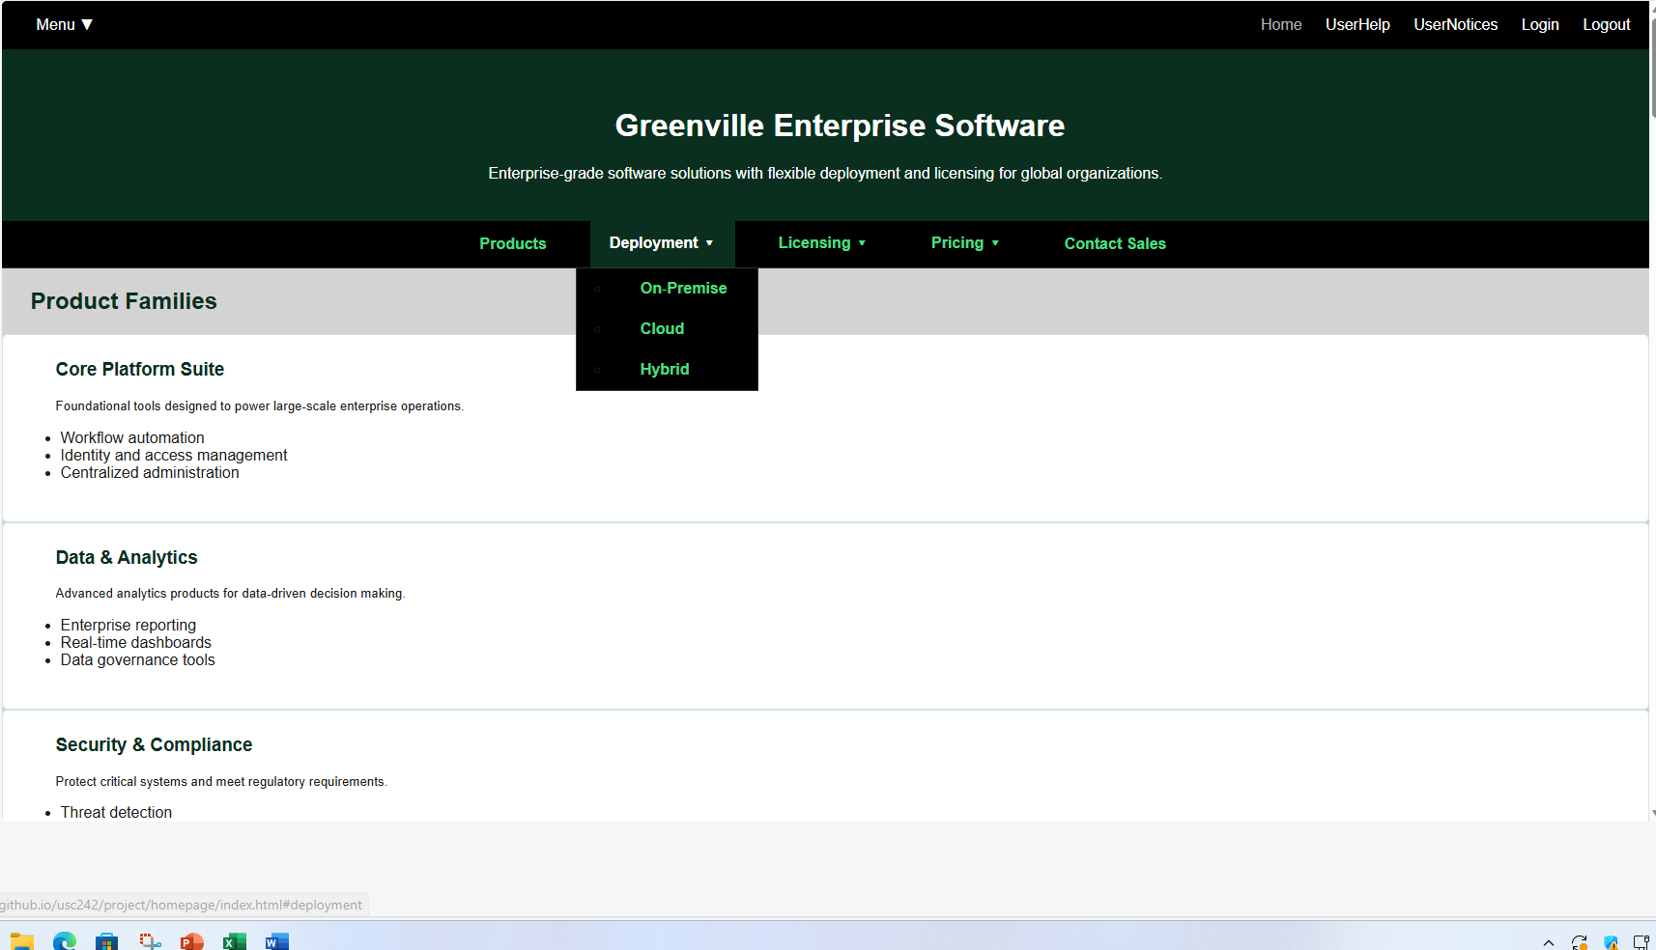

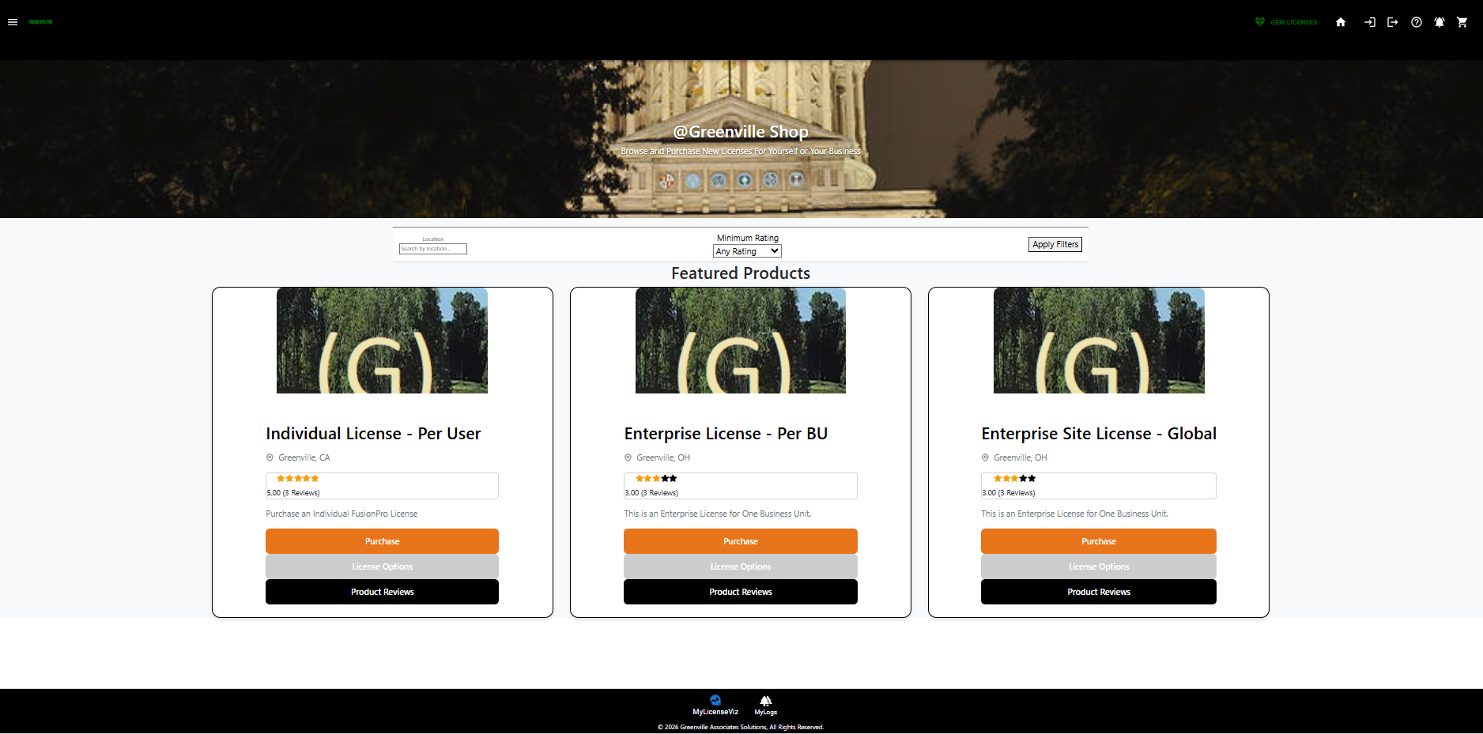
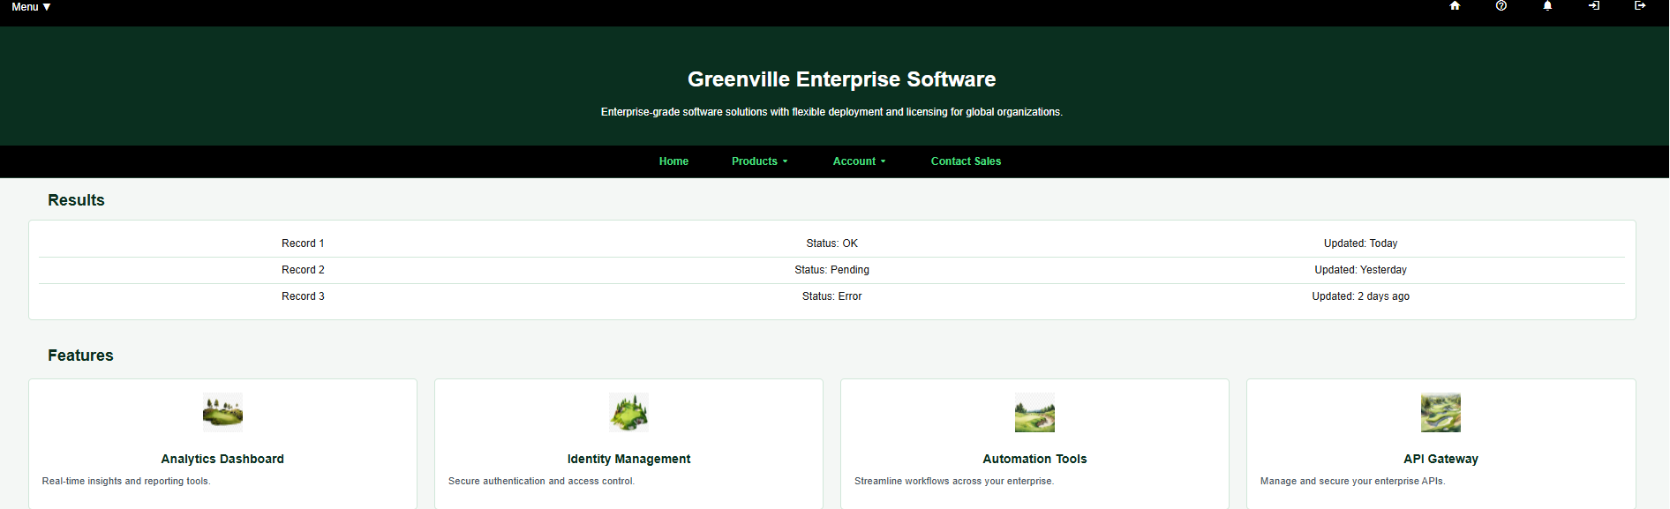
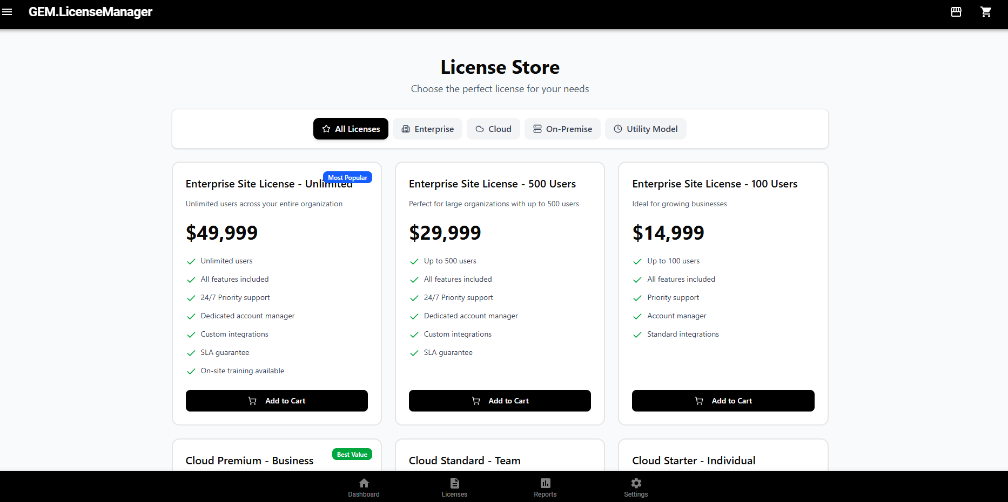
REACT AND HTML TARGETS VIRTUALLY THE SAME And Migrating to common form
Blowout…
TopNav
Center Nav/Filtering
Main Panel with Data…
HTML Target Gen2 – Looks Beautiful But Missing Material UI Icons Top & Bottom.
FooterNav
React Legacy EU Model
(Valefar/CG UserStories & Design)
Gen0
GEN3 with Material-UI Icons on HTML To replace top and bottom nav by text links…
The AI Generated Template Built Admin Pages/Dashboards + New Cart which works.
It is not formatted to match target but the AI build identified a number of significant options like Settings.
Gen1 – Reverse Engineered UI from JSON

Slide 6
Screens in 4 block format…
All Screens(Current)
Before Target CSS is Universally Applied to All Tags

Slide 7
Before we show current screens…..
We are trying to get Greenvilletwo.css to encompass and consolidate all CSS parameters across all 20+ pages…. Its not quite working right…. 1+ days more…to debug….
Current Screens do not have greenville2.css applied and were developed by Gen-ing the data to REST APIS using bootstrap on copilot…. In other words Copilot builds from REST entire working Grid Arrays with Update, Insert and Delete… given the right prompts/parameters.
Current screens are moving to a common base but we are playing with background screen colors, etc which we haven’t quite decided on….

Slide 8
THE TARGET SCREEN IN SECTIONS
Top Nav (Main Button Drop), Site Name and Logo, Right Nav Icons.
MidPage Heading and Nav (Like Homepage)
Main Data/CenterCourt with 2 subsections(Data/Features)
BottomFillers (3 x Wide, 1x3 in Media Checker tested and in production)
Bottom Nav (Two Icons and Copyright is target)
NOTE ALL SCREENS HAVE THE SAME COMPONENTS IN OUR MODEL… THUS SHOWING EACH ONE ISNT REALLY NECESSARY…. IF THEY USE THE SAME CSS.

Slide 9

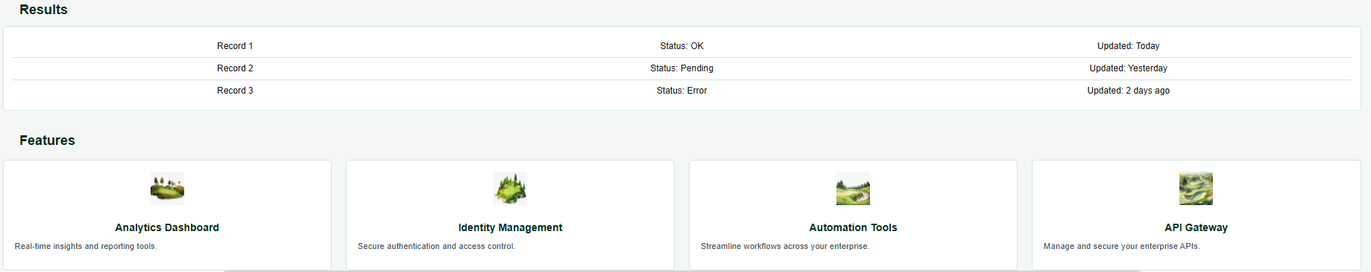
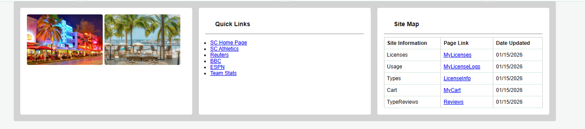

SECTION ½ -> CONSTRUCTING A SCREEN…. TOP SECTION FIRST
SECTION3 -> MAIN DATA AREA (A Grid Data Area, and Feature/Idea Section)
SECTION 4 -> PORTIAS FLEX BOXES 3x1, and 1x3 on Media Check at 1000px
SECTION 5 ->STANDARD BOTTOM NAV(5)

Slide 10
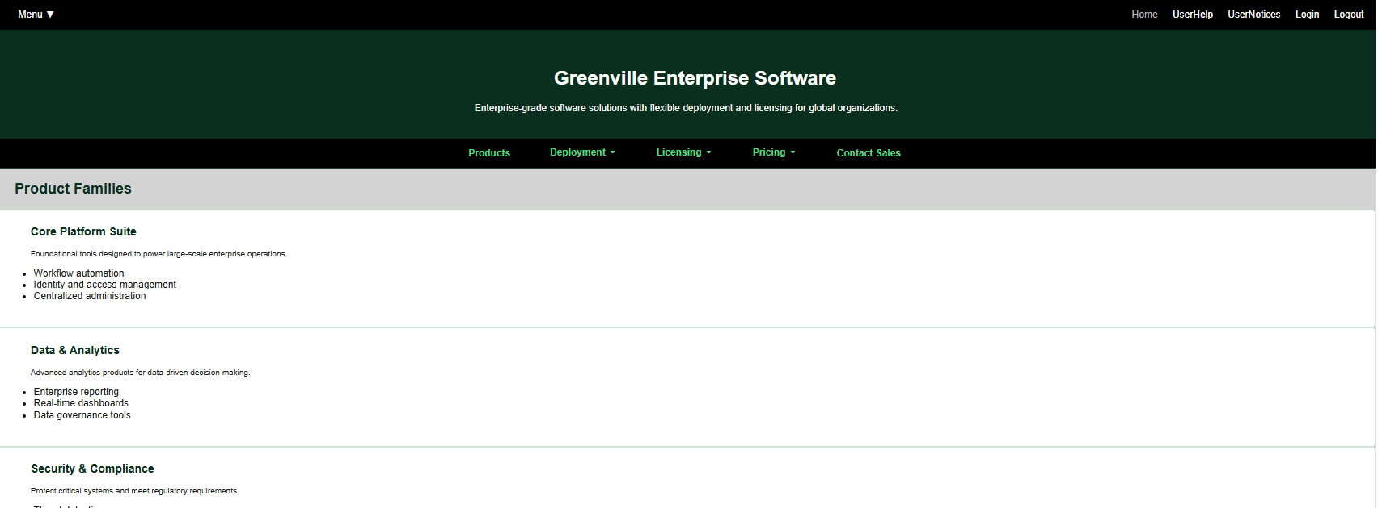
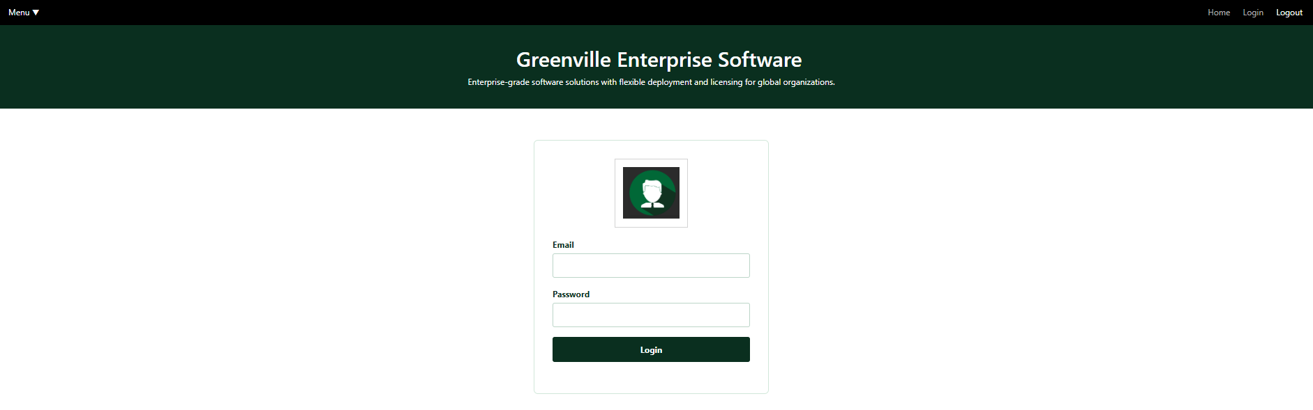
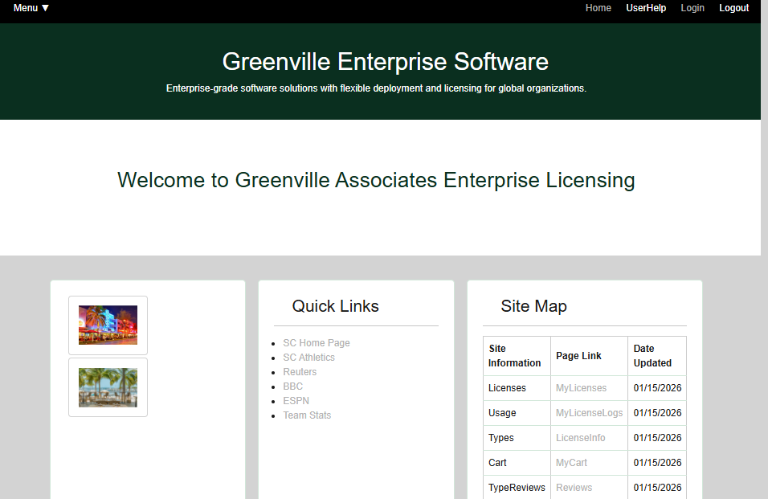
INDEX.HTML
LOGIN.HTML
LOGOUT CLEARS
VARIOUS PARAMETERS AND REDIRECTS TO INDEX.HTML
WELCOME.HTML

Slide 11
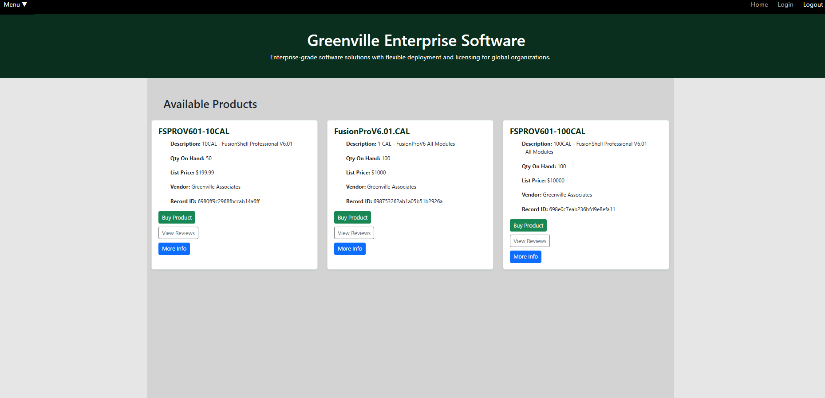
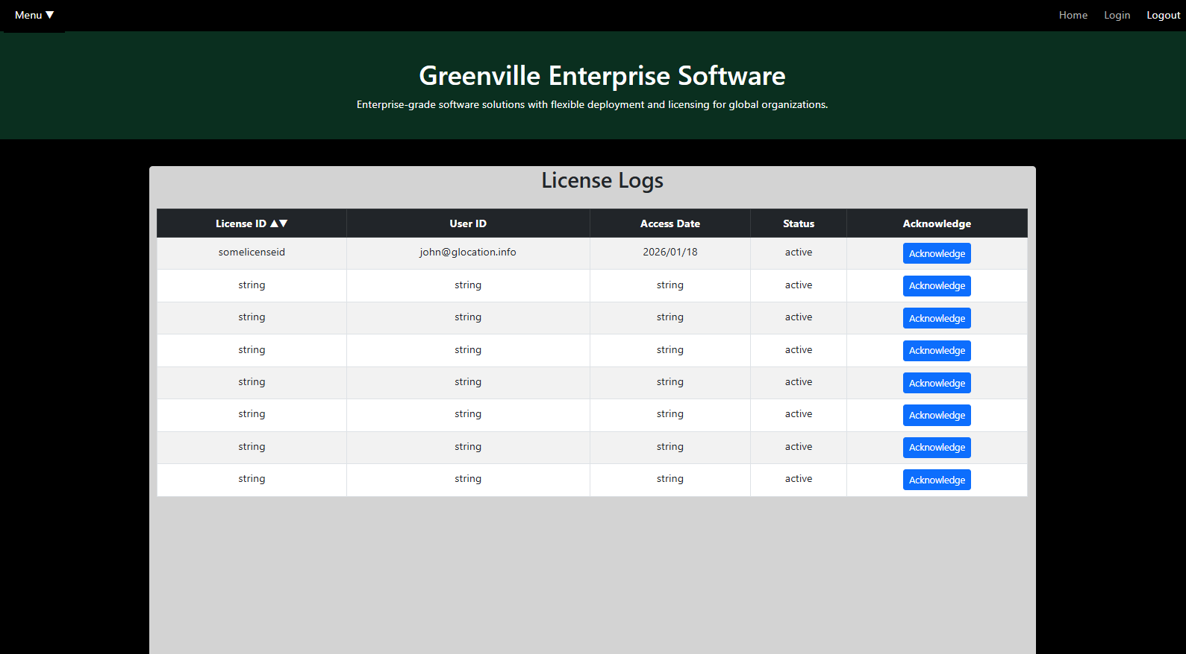
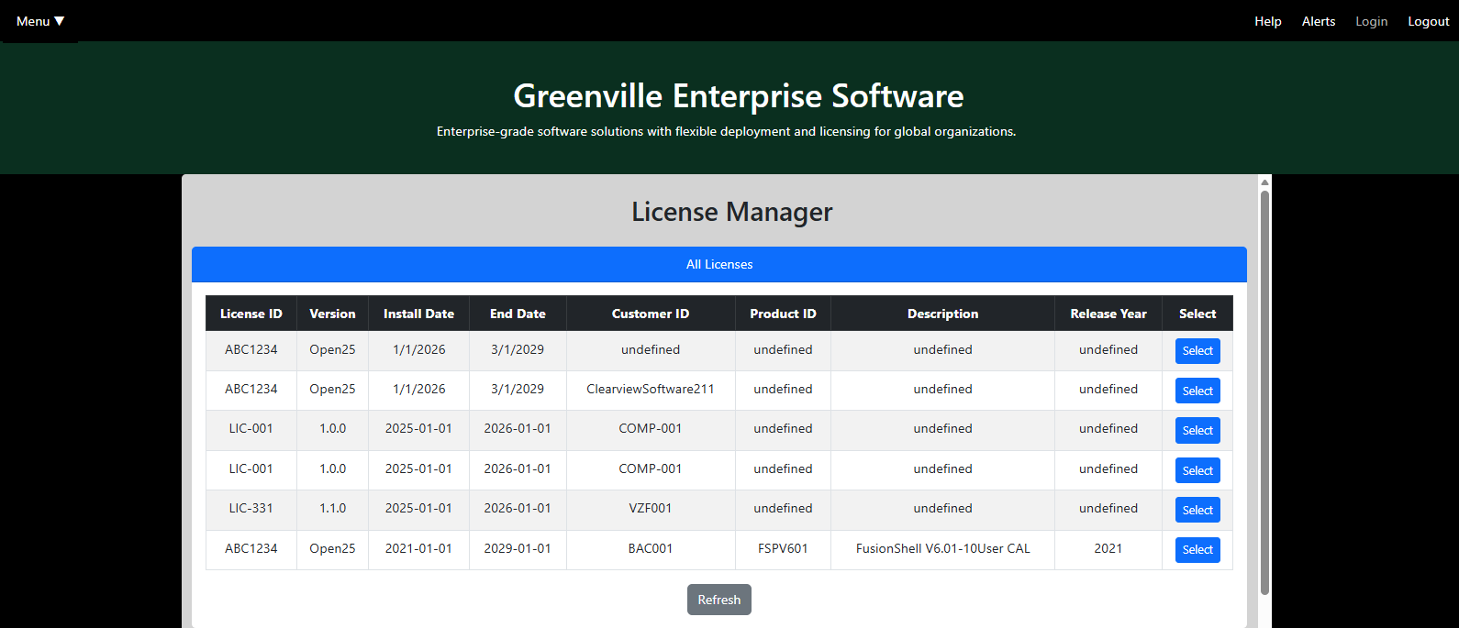
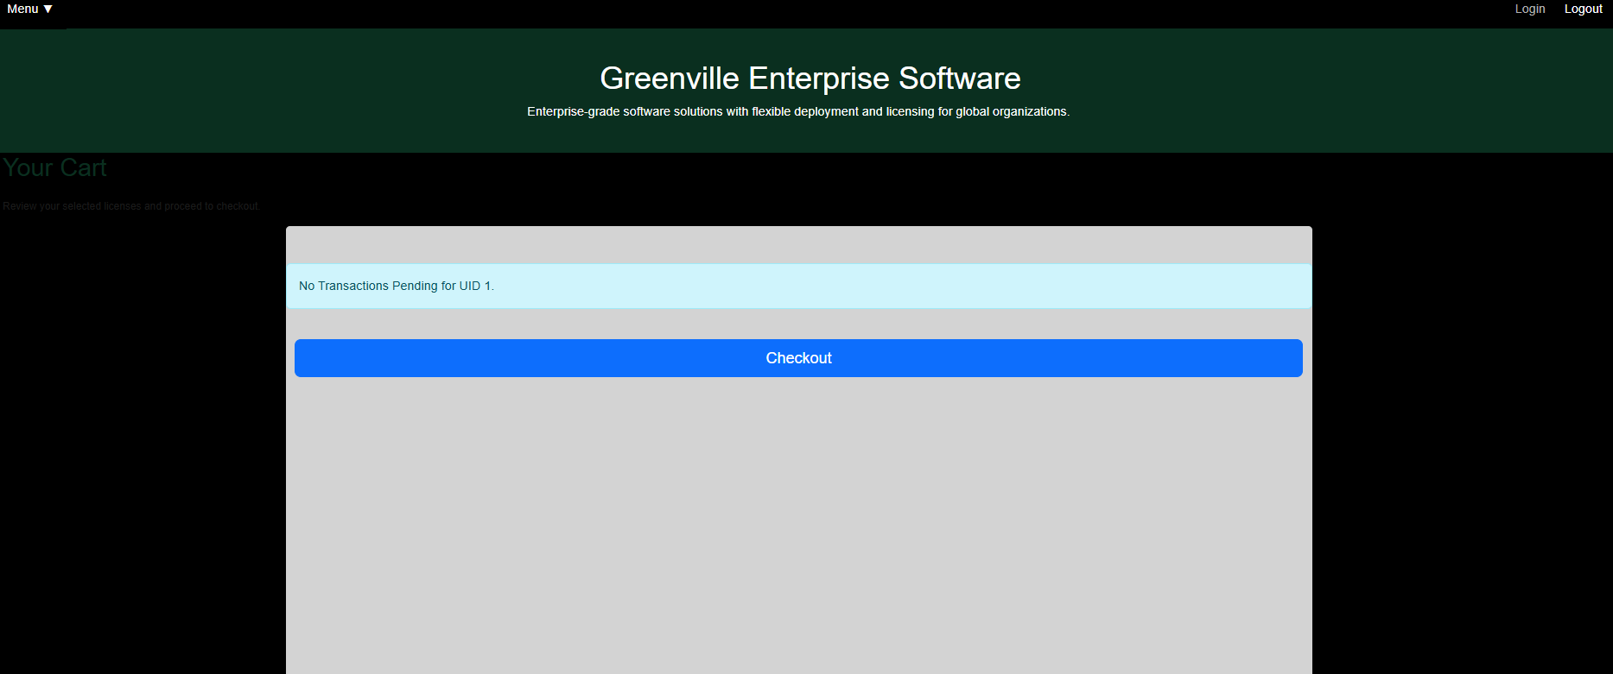
Licenses6.html -> Main Buy Page….
MyLicenseLogs.html (UserLogs)
MyLicenses.html(UserLicenses/CorpLicenses)
MyCart(Pending Items to Pay)….

Slide 12
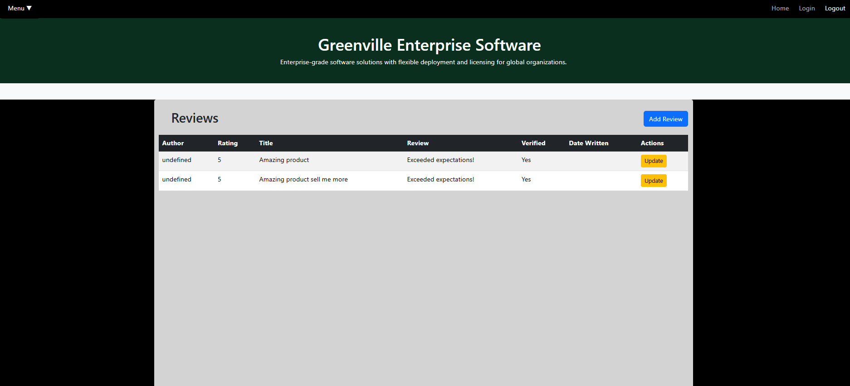
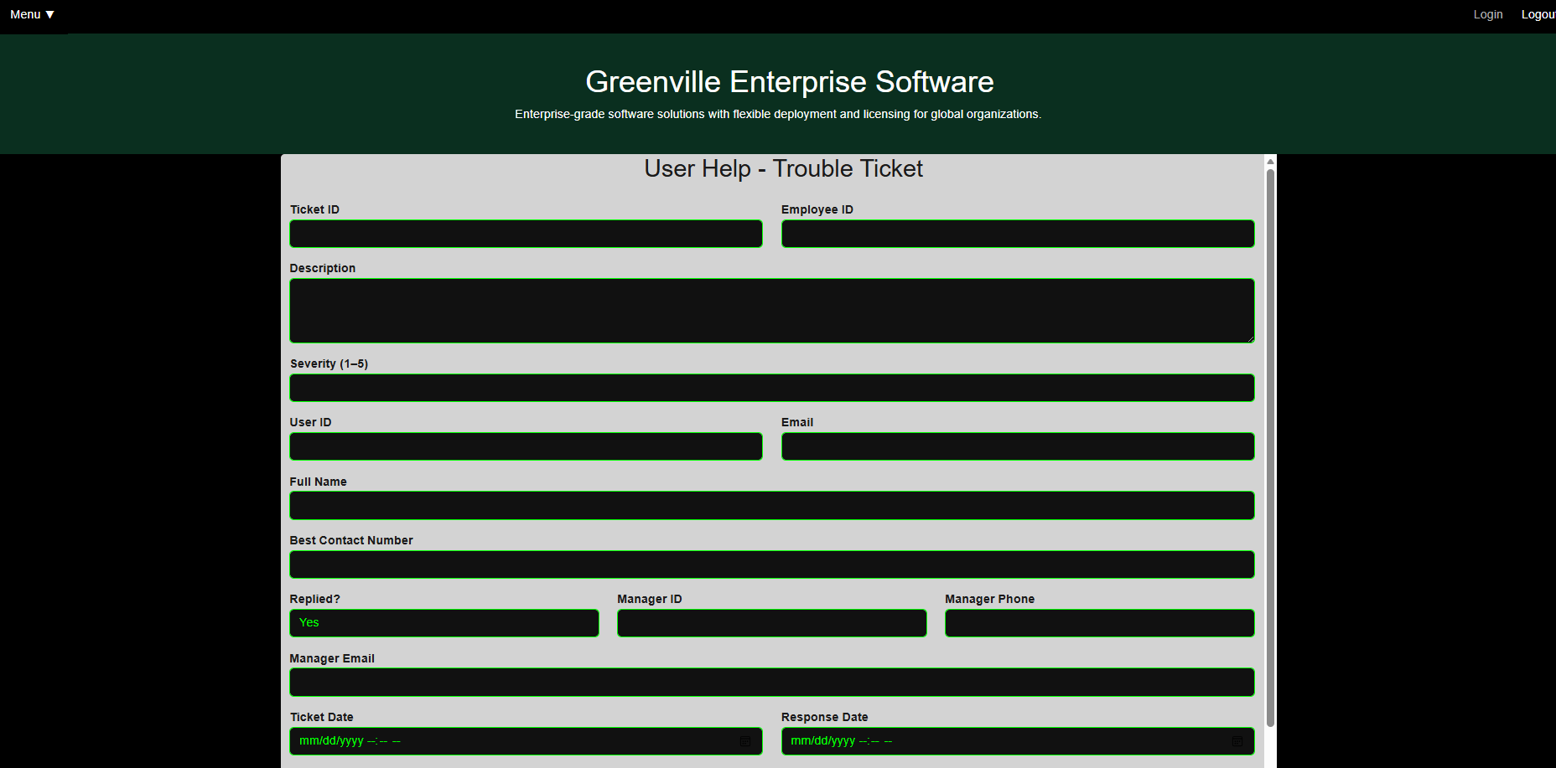
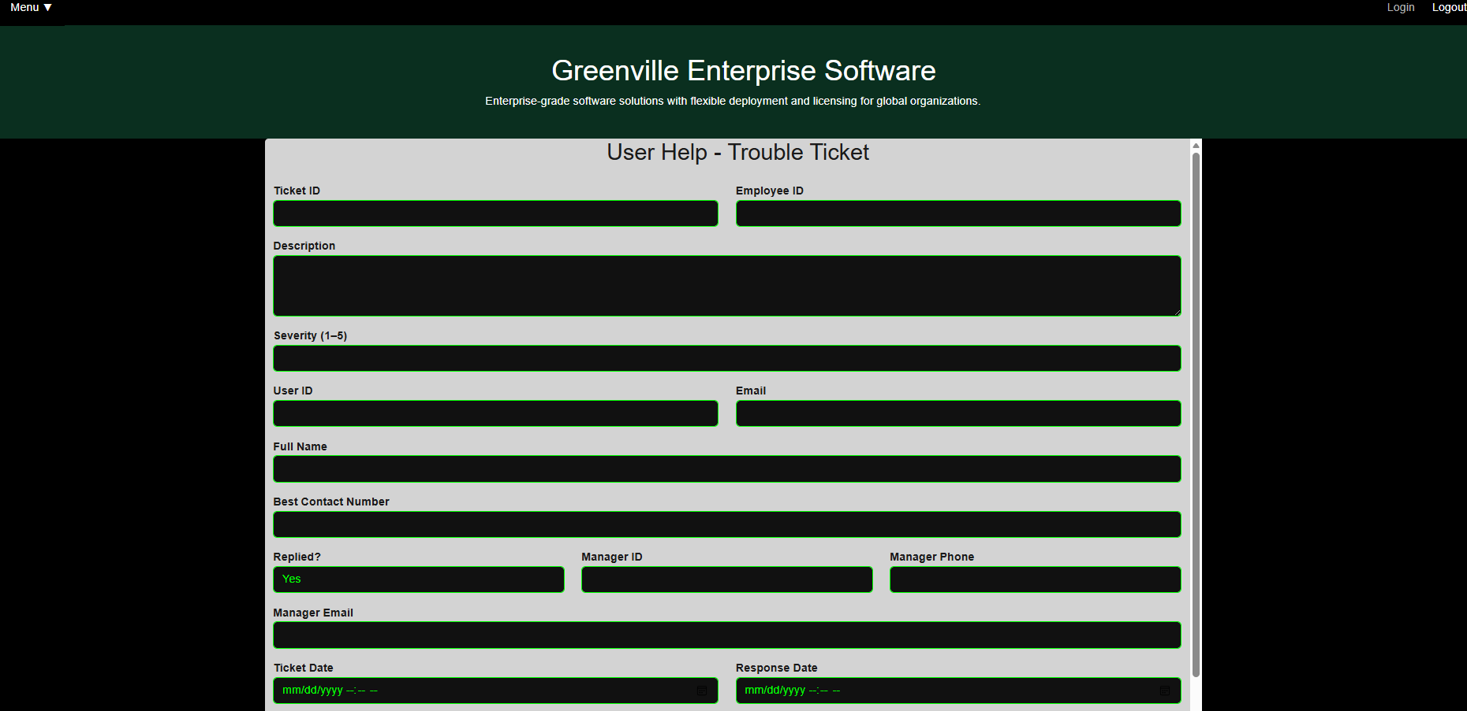
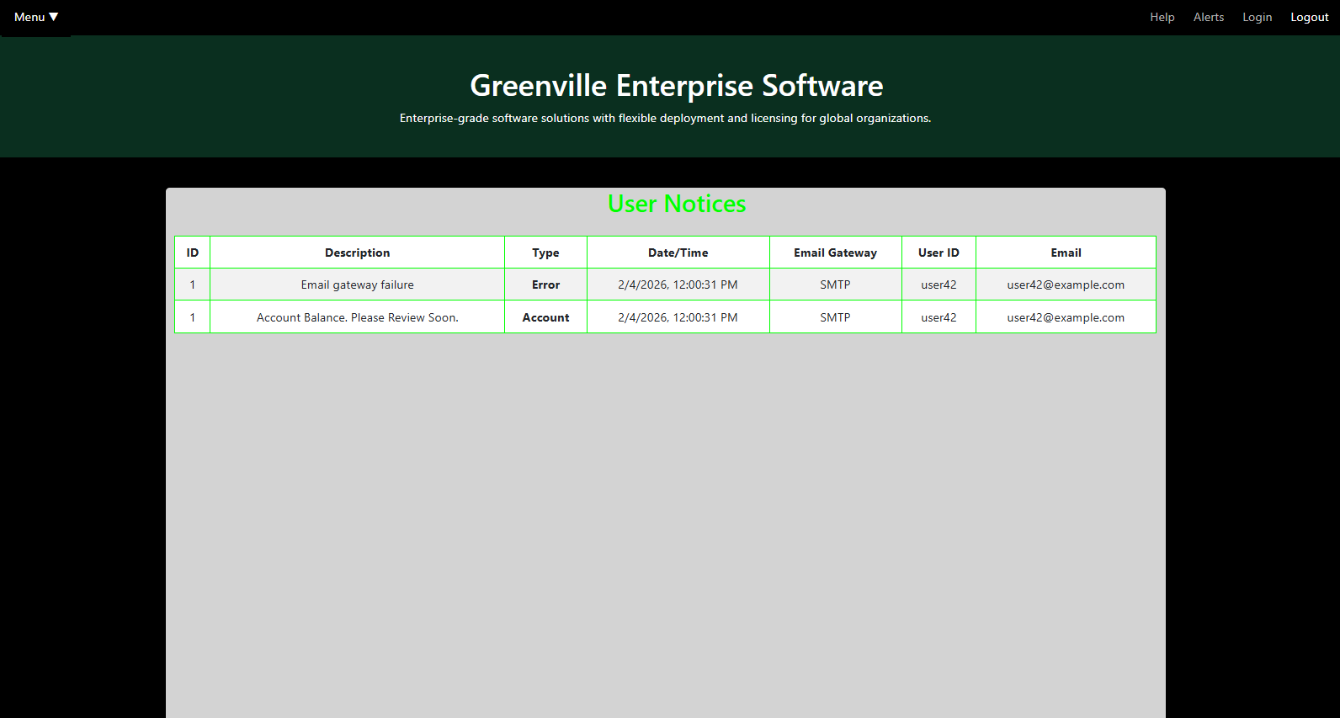
Help(10).html
Reviews.html(9)
UserHelp.html(11)
UserNotices.html (12)

Slide 13
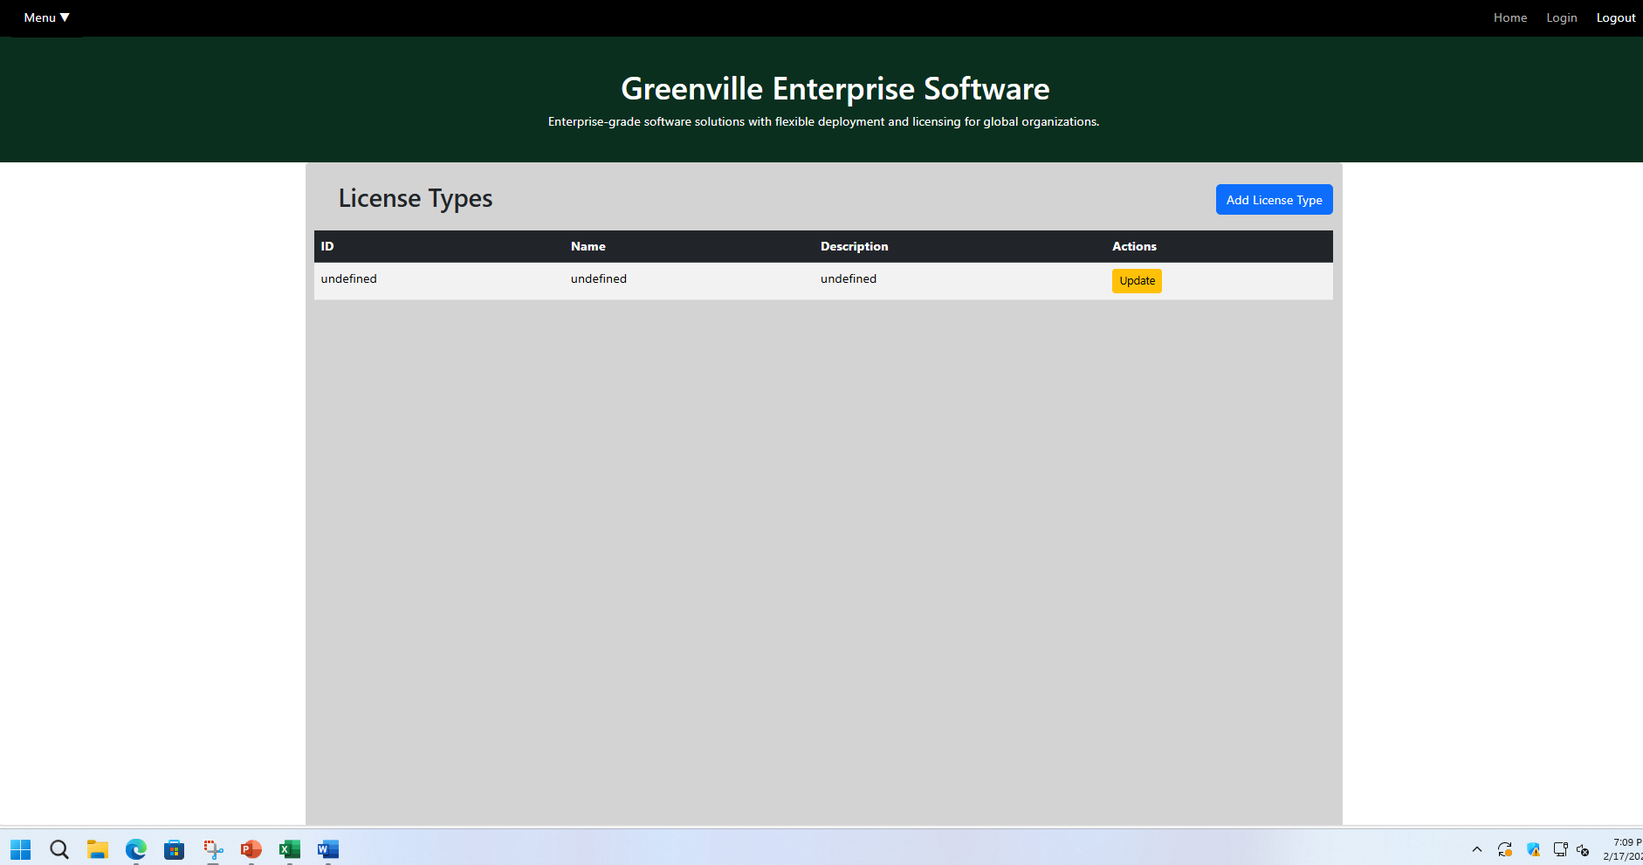
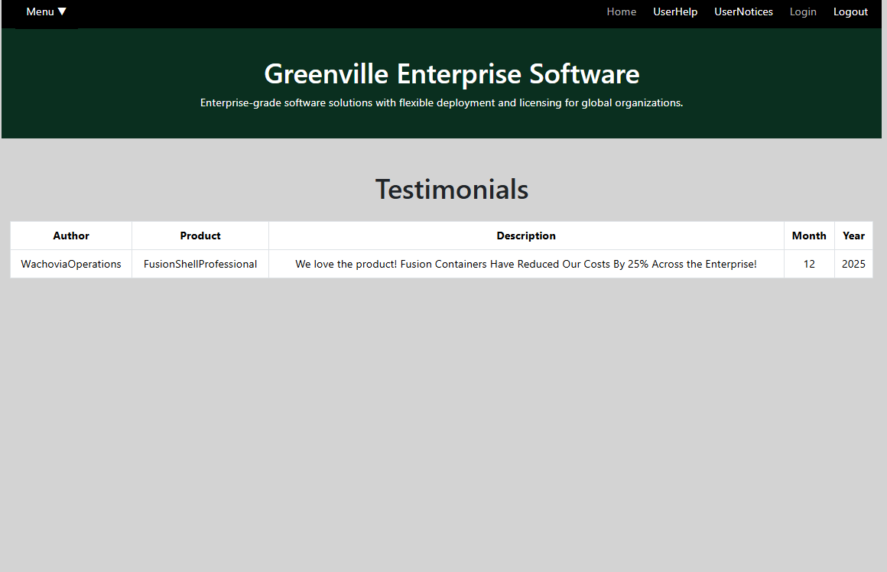
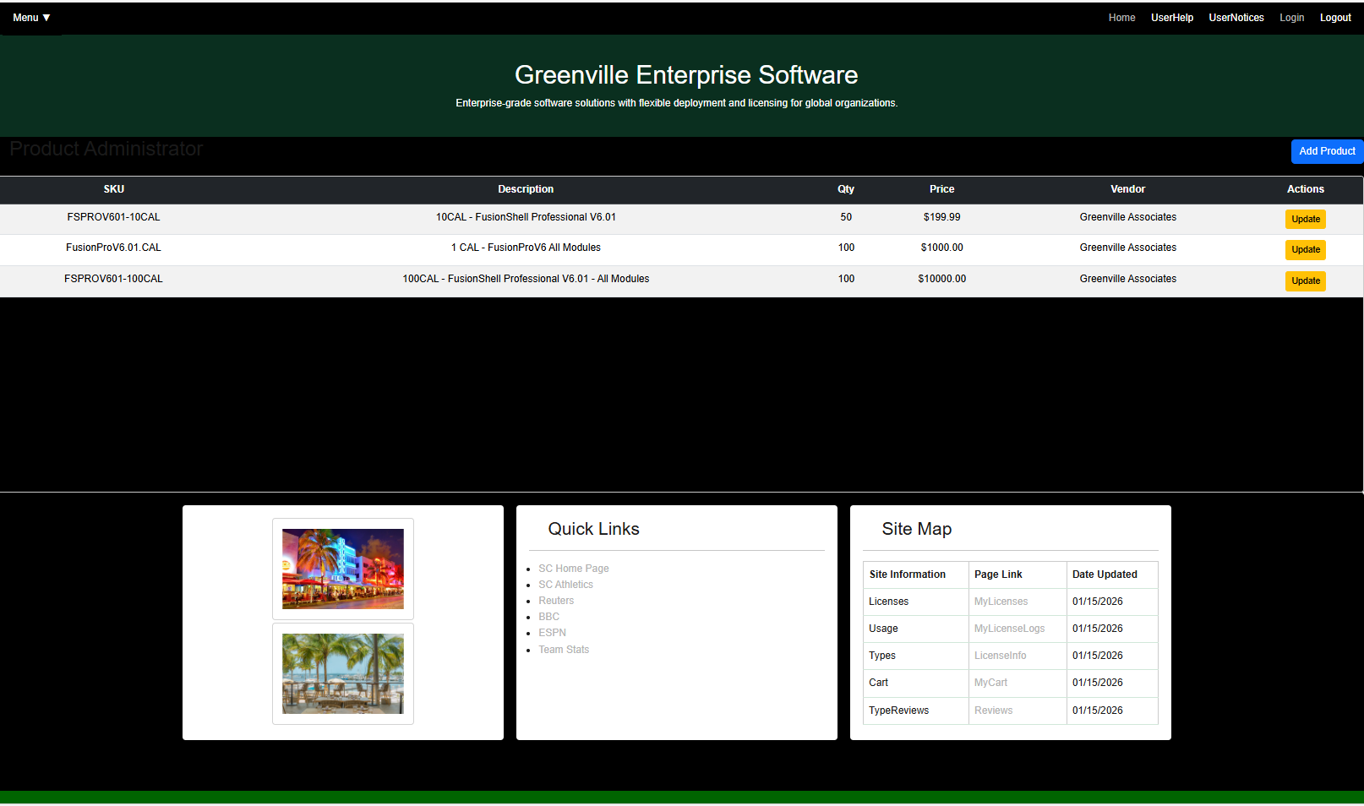
ADMIN PAGES
LICENSETYPES.HTML(ADMIN)
PRODUCTS.HTML(ADMIN)
TESTIMONIALS.HTML(ADMIN)

Slide 14
SHOPIFY FIGMA PLUGIN vs FUSION COMMERCE
Figma Designer has shopify plugins working…..
This eliminates the need for FusionCart for this application.
Fusion Commerce is a world class ecommerce system with full payment control and supporting of any type of product (reservations/dates, mrcs, nrcs, global, state, regional boundaries).
Fusion Commerce supports Batching to a 3rd Party Accounting System -> SalesOrder -> Foreign POS Systems
For this class Shopify may or may not be easier… Note if we Make Park Table emulate a Product… we can keep it without modification….so this is an architectural consideration. (This is already done in react UI). In other words if we rename a park a product it works without modification.

Slide 15
Other Screens
Figma has a onesy… which shows products, product reviews, and testimonials in the Main Data Area…. This should be table driven to an API… so its not a new screen it’s a recast on the home page…
In the end…. We envision a main sales page….
And once a user logs in… its pure operational….
View Licenses, View LicenseLogs, Buy New Licenses, Upgrade Licenses…
To Upgrade a License… each product has to have an upgrade path(SKU), and price for the upgrade SKU…. In place… this needs to be table driven.

Slide 16
CART PAGES UNDER CONSTRUCTION
2/17/2029

Slide 17
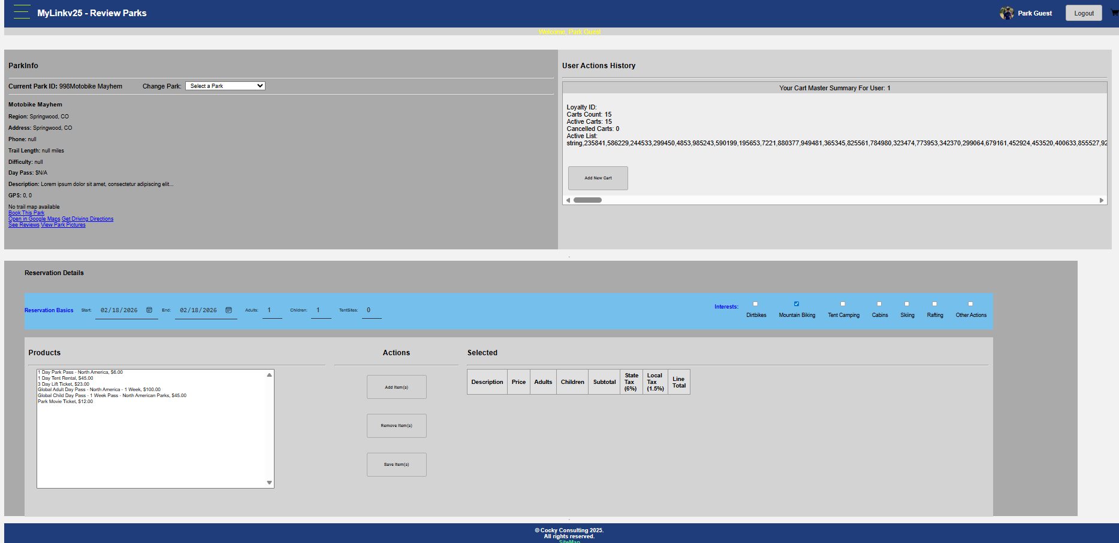
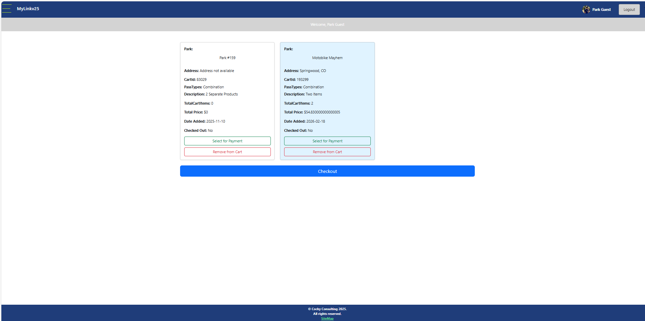
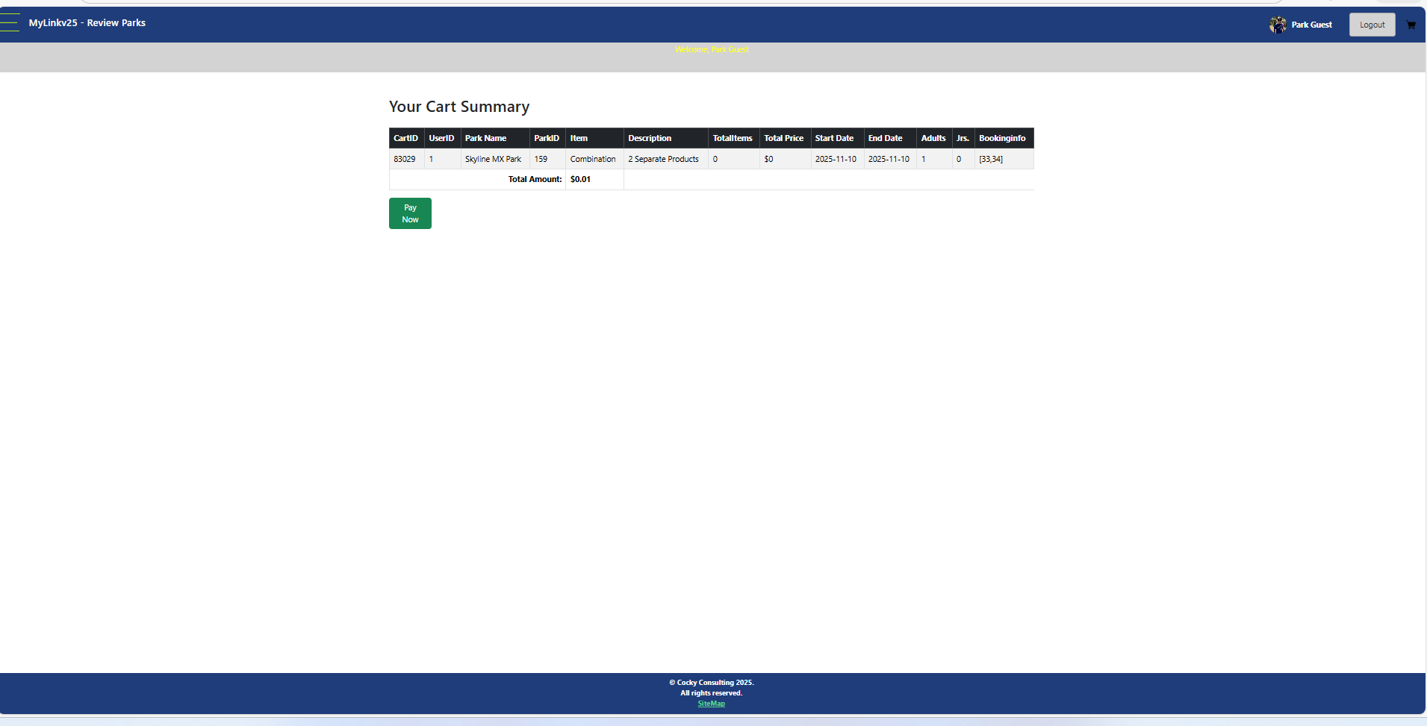
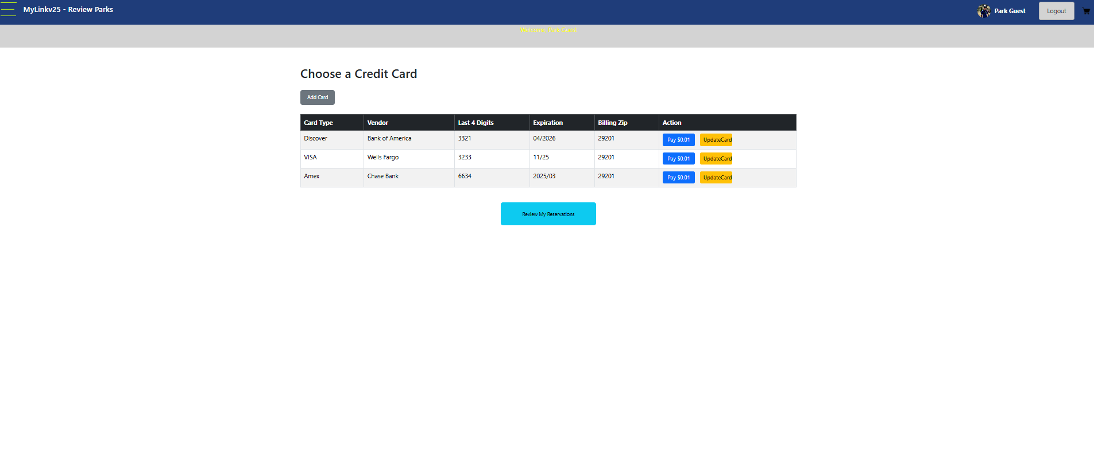
Cart Pages… have not been yet ported from G/A 547Bikes.info yet… but are numerous…. Target to match G/A corporate colors, and MRC/NRC driven products which already exist in pricing tables… Bikes sells tickets, and MRC/NRC Items today
Book555.html
Cart5.html…
Payments8.html
Paynow2.html before payment….
There are more than 5 admin pages for Cart Dashboard Data… And Reservation/Invoice Management.

Slide 18
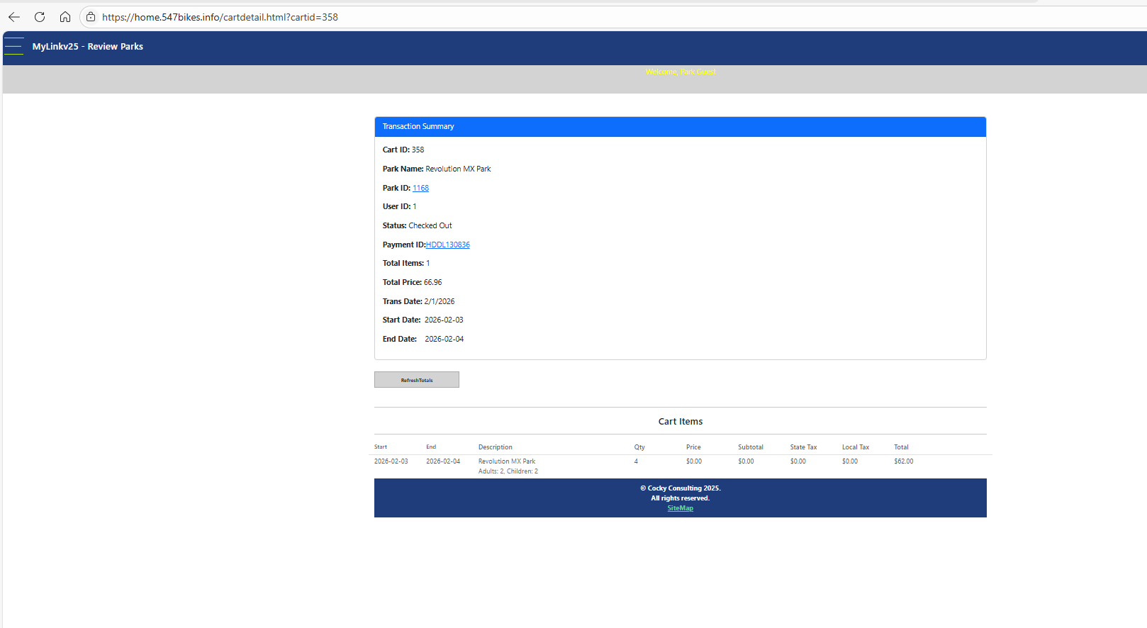
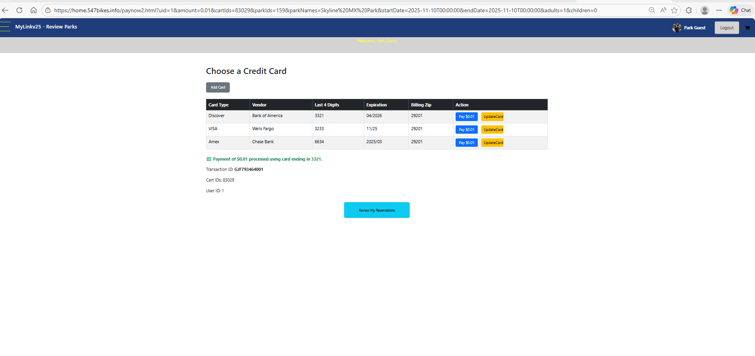
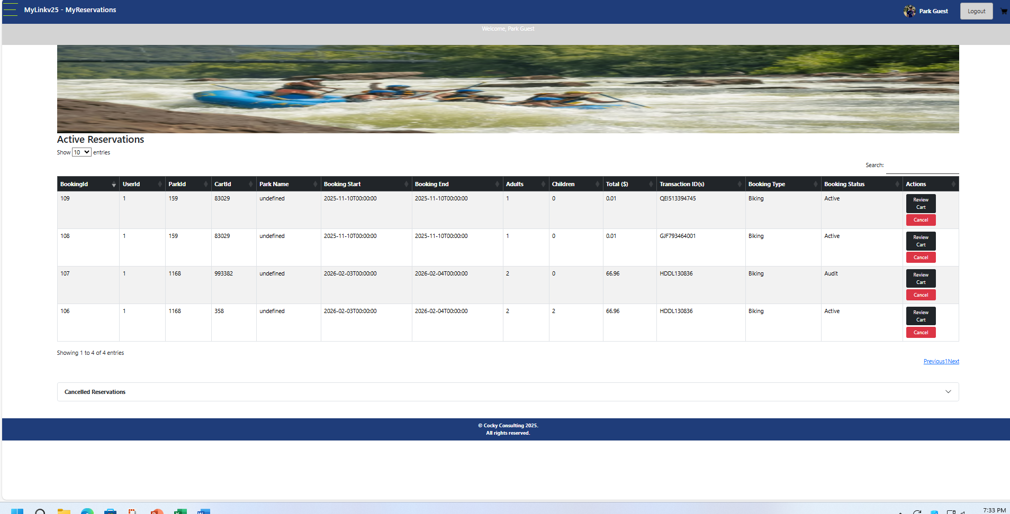
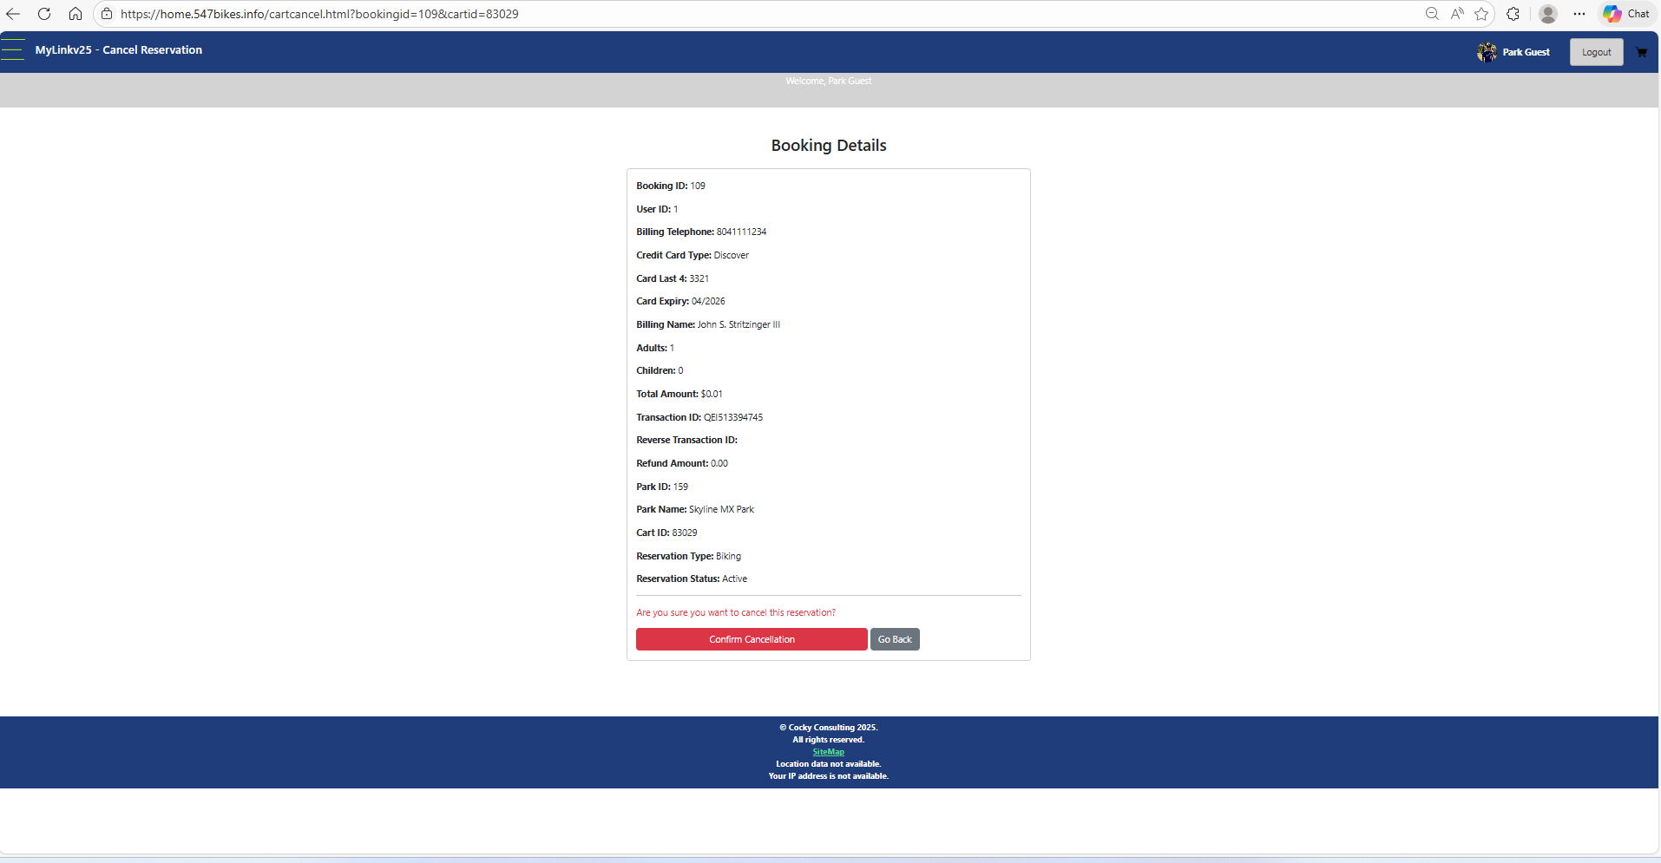
Other CART Pages
Paynow2.html -> After Payment
Cartdetail.html shows a single transaction.
MyReservations is a very very complicated page… with option to cancel pending reservations.
CartCancel -> Cancels a Reservation and Reverses Charges to a Credit Card…

Slide 19
MODIFICATIONS
2/22/2026

Slide 20
MODS
We modified the entire cart to working with the MongoDB back-end rather than the parks api… this was a major work effort… furthermore the Parks API had lots of intermediate endpoints and services which took MONTHS to build…
We are about 65% interoperable at this point… Reads Work, but Updates, and Posts are spotty due to referential integretity on key fields.
We rebuilt the home page, and moved pricing and deployment details to separate pages. We built a sales wizard page that calculates a price after asking some questions….
Interior Nav is complicated and is not completely modeled.

Slide 21
USER STORY
Homepage unprotected from SSO Privacy…..
Attempting to Buy Something….. Forces login….
Login.Html updates SSO data/user profile in LocalStorage
All other ops pages PLL Protected(Page Level Locking) to uid in LocalStorage.
After Login -> Force to MyLicenses -> Options to Buy More/Upgrade.
Other Operational Items on Drop Menu.

Slide 22
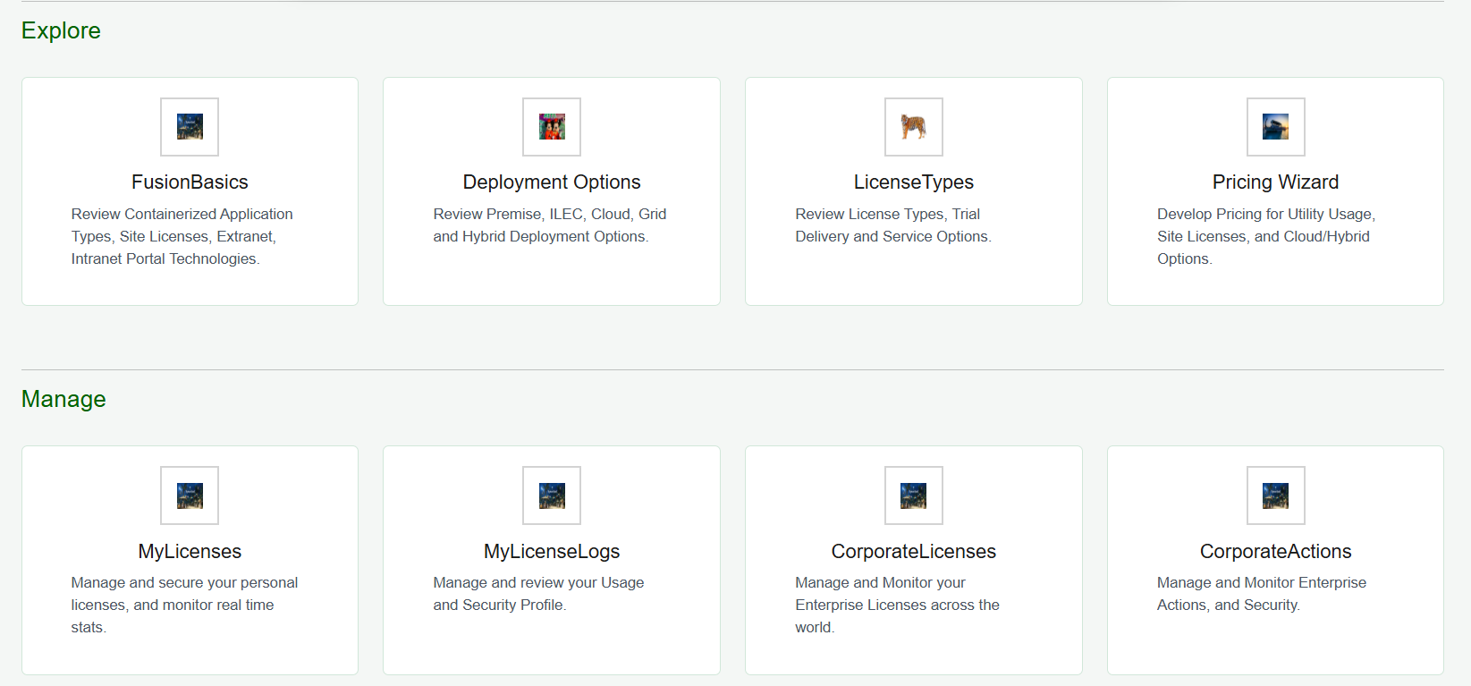
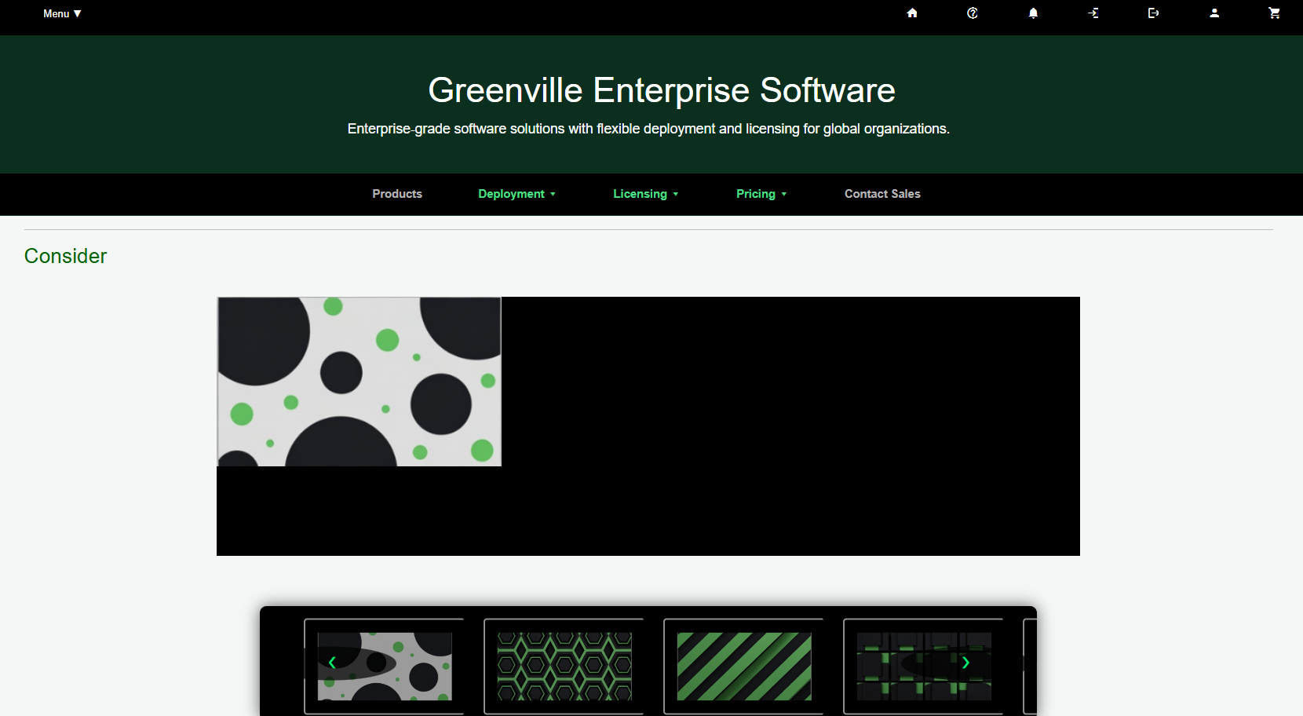
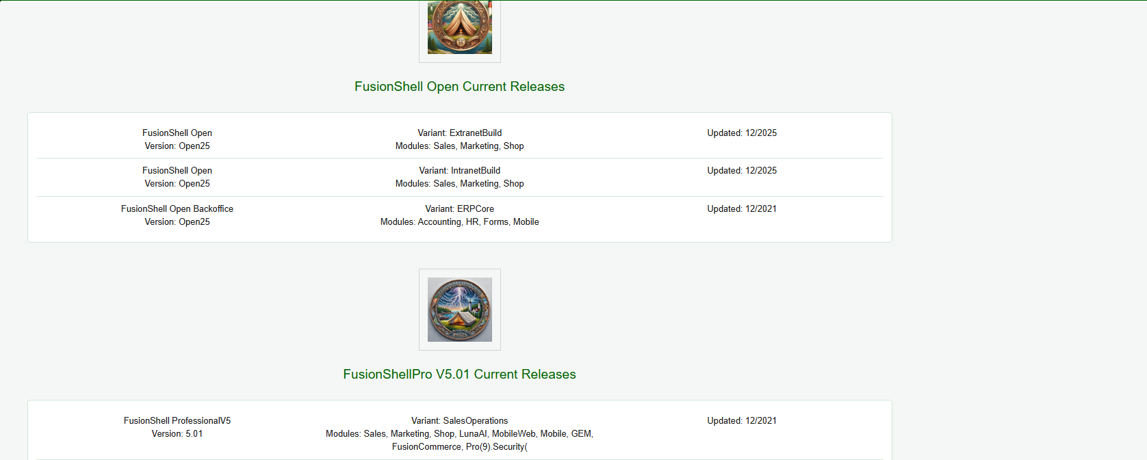
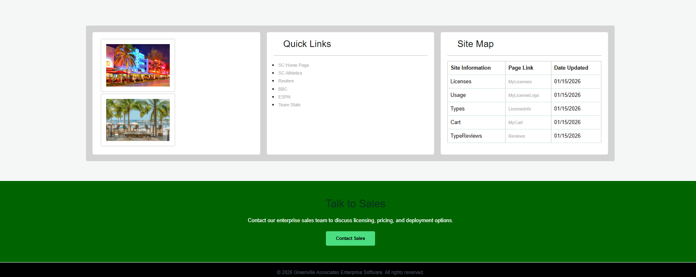
New Homepage…
MIDSECTION…..
(2)
(3)
(4)
(1)Consider Slide Show with Iframe….

Slide 23
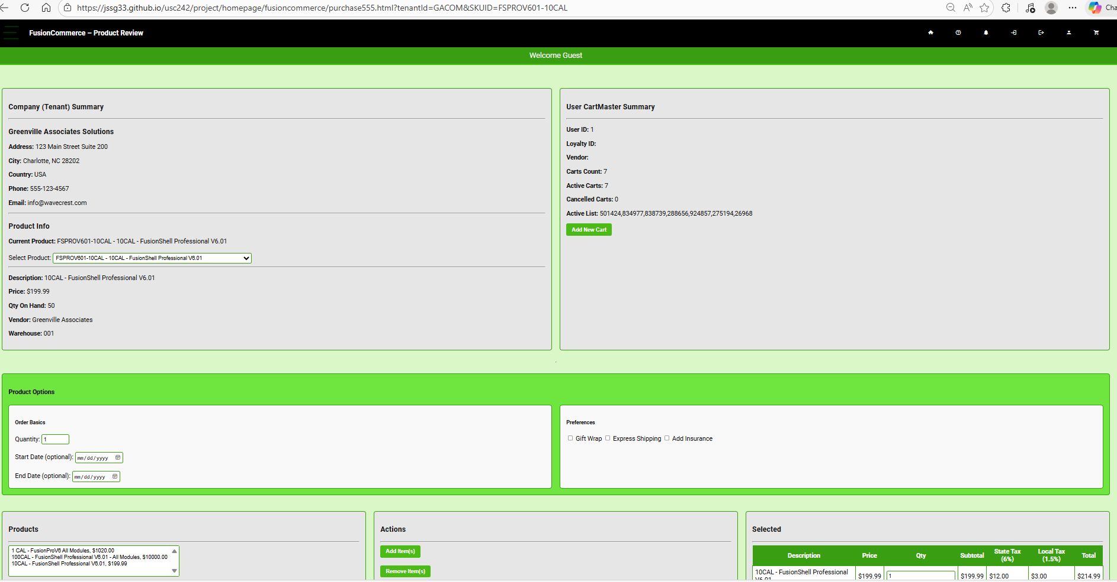
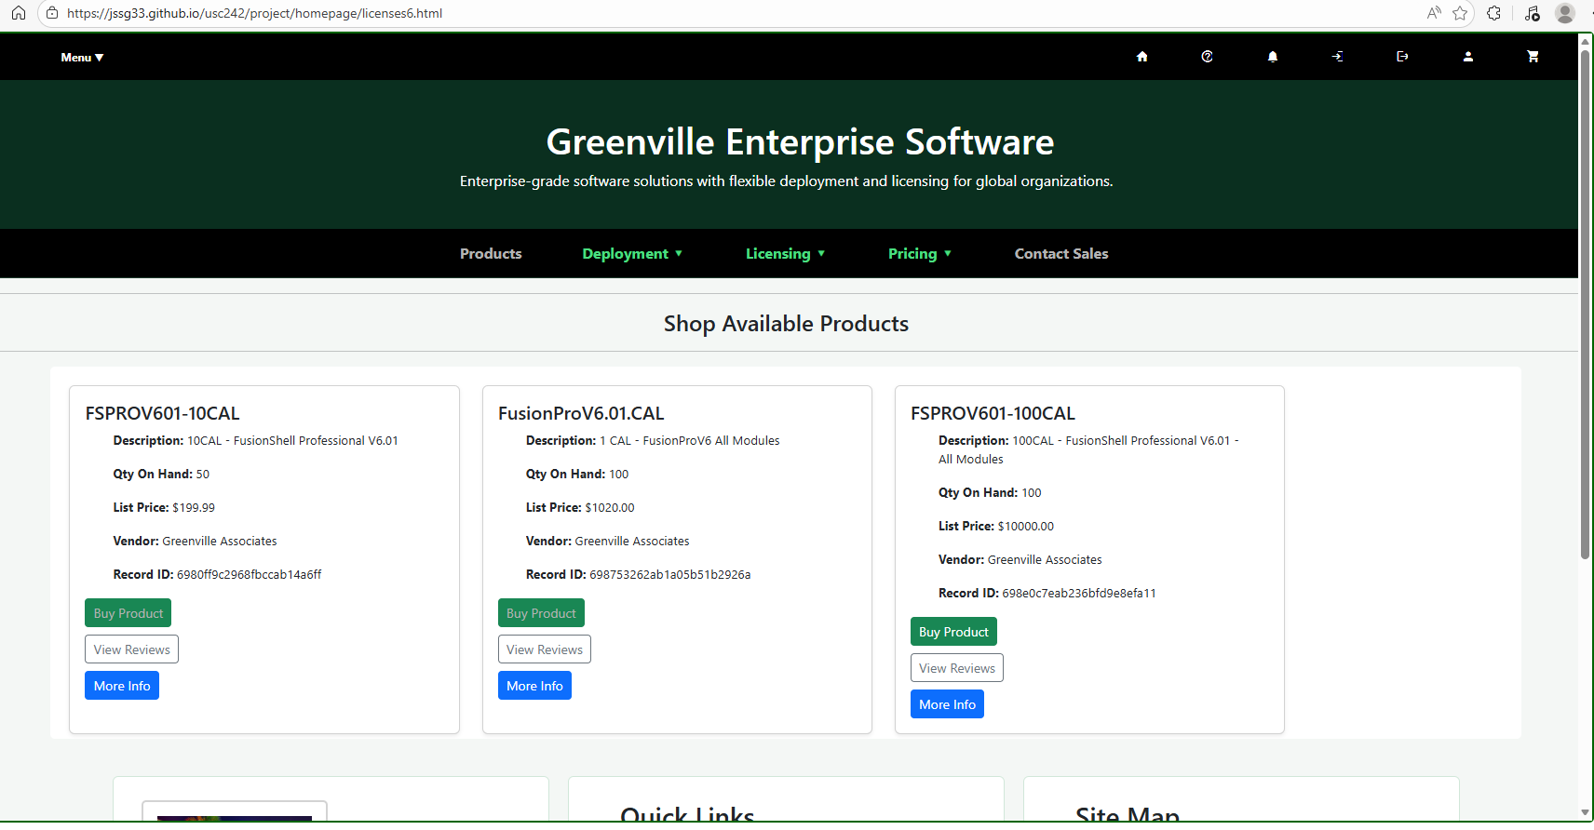
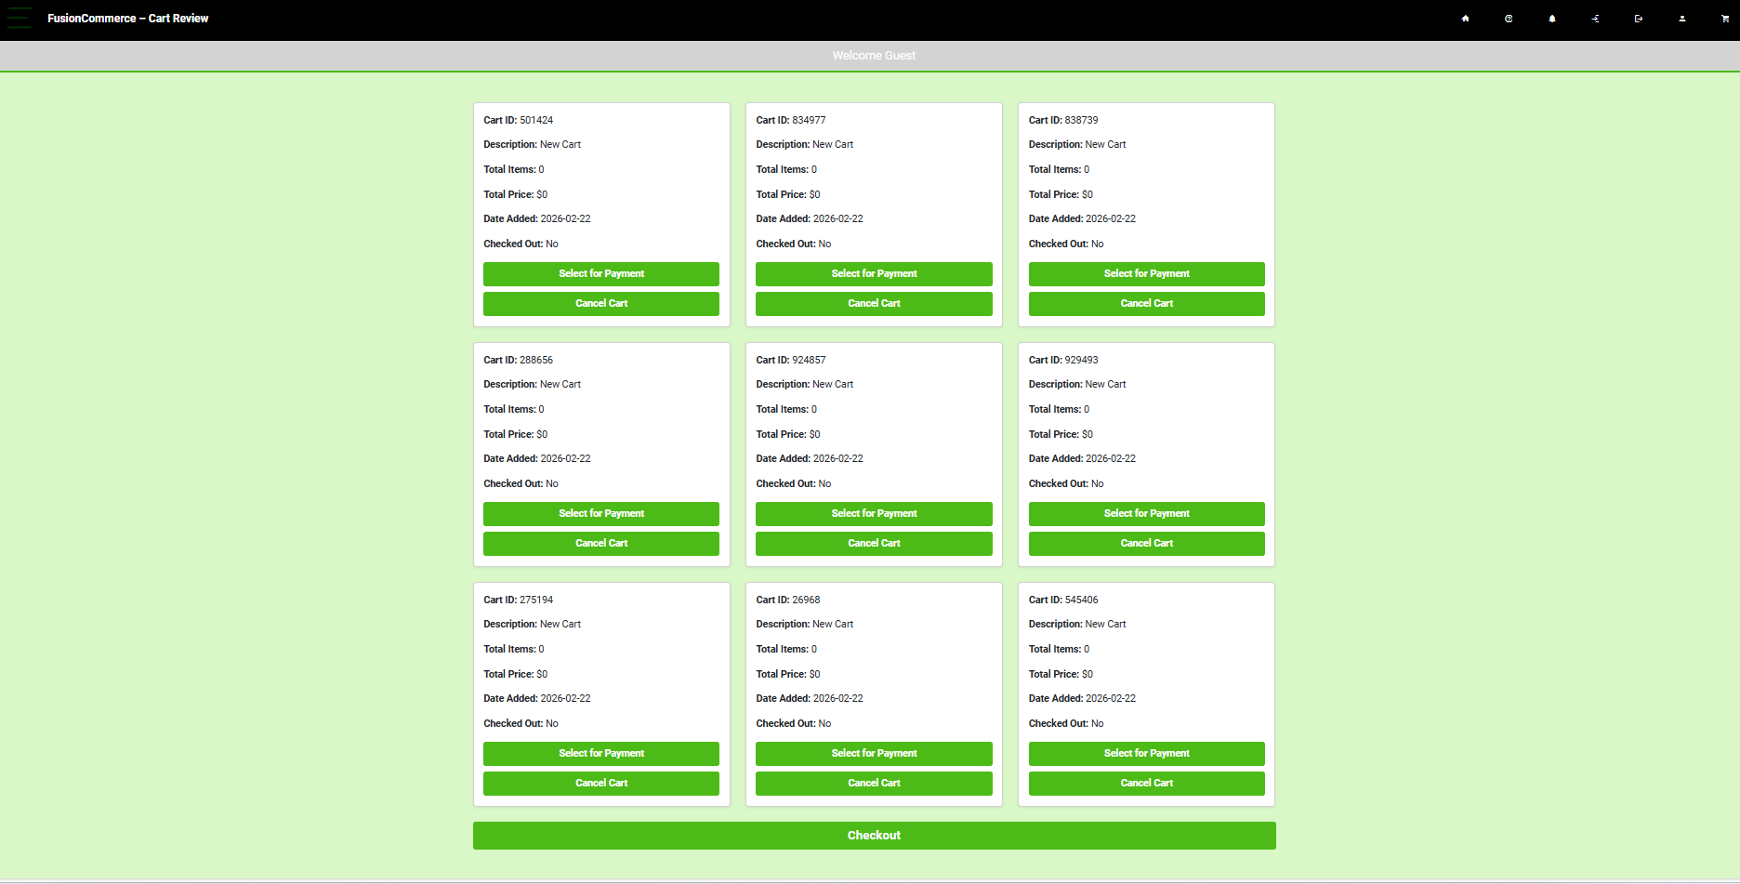
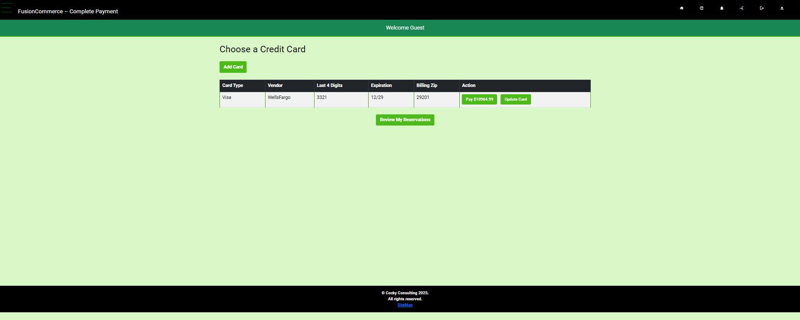
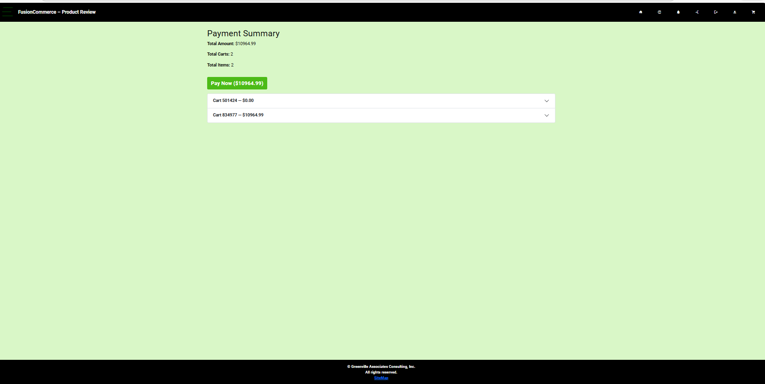
LIGHT GREEN SHOWING 2ND DRAFT
Cart Pages… Have been ported in Part to ./fusioncommerce… to the same UserFlows we think were accurate…but with a twist
Book555.html
Has been replaced with
Purchase555.html
Which works similarly…except now showing corp
Licenses6.html
Has Replaced
Parks5.html &
Is Finished.
CartReview.html Is Unchanged And Works just as well..
Payments8.html is now working more or less the same…
Paynow2.html before payment…. Is Unchanged
There are more than 5 admin pages for Cart Dashboard Data… And Reservation/Invoice Management.

Slide 24
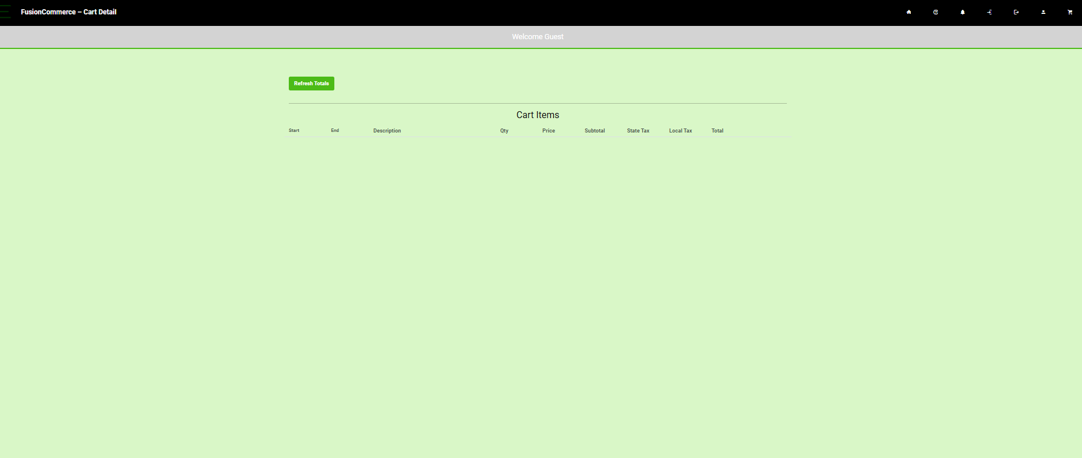
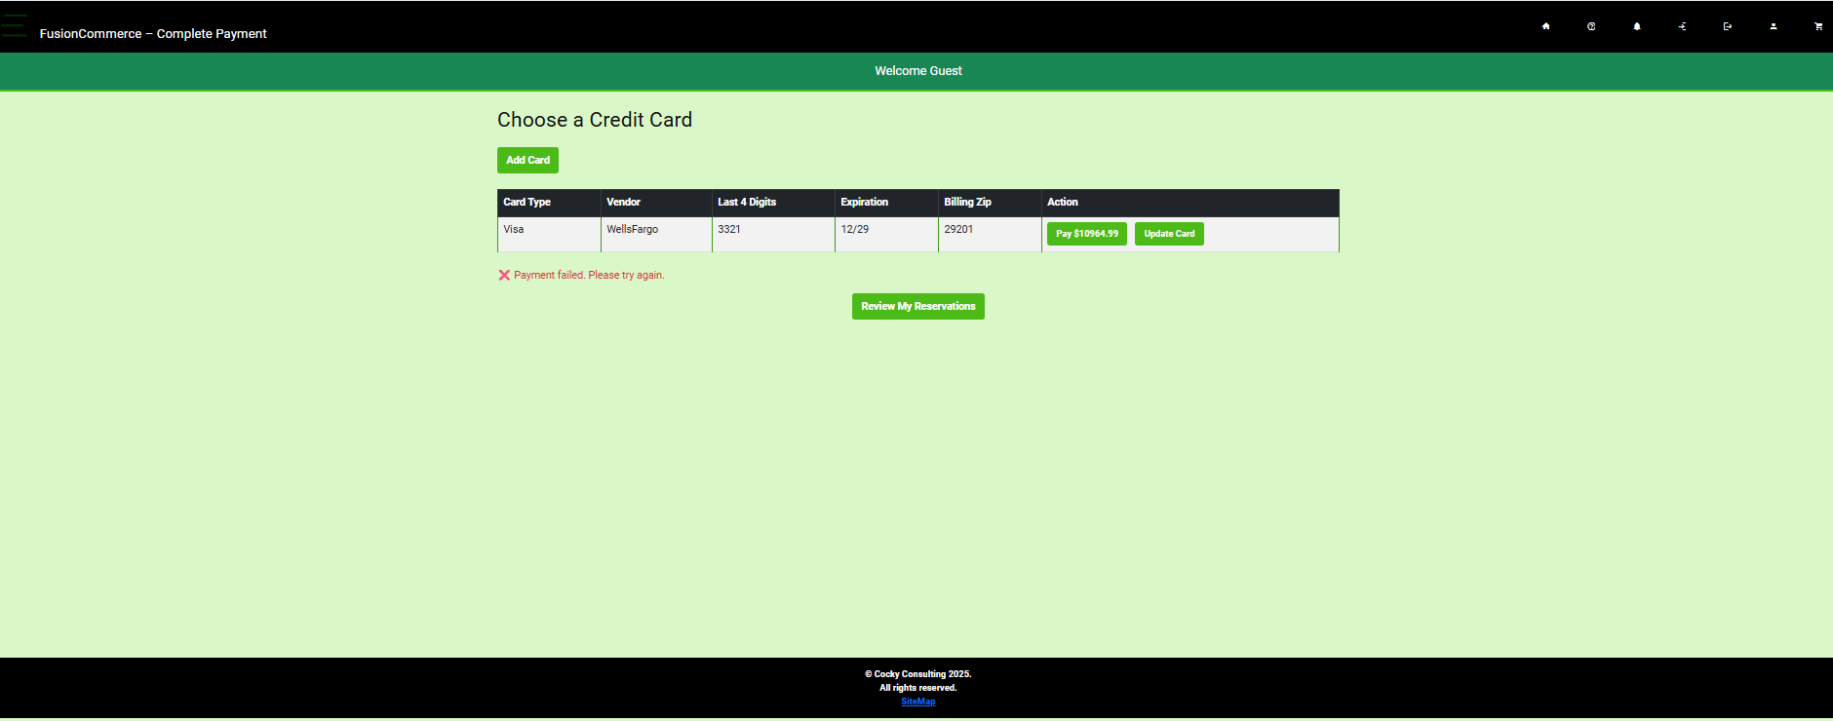
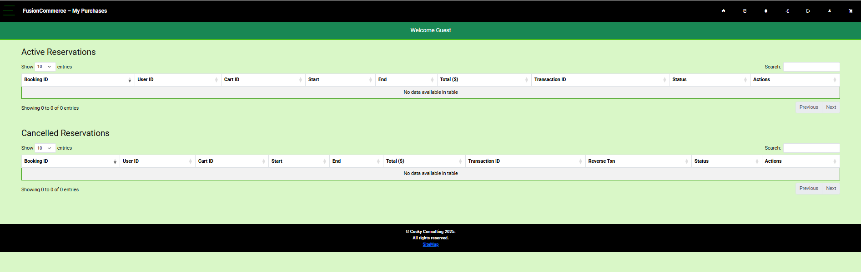
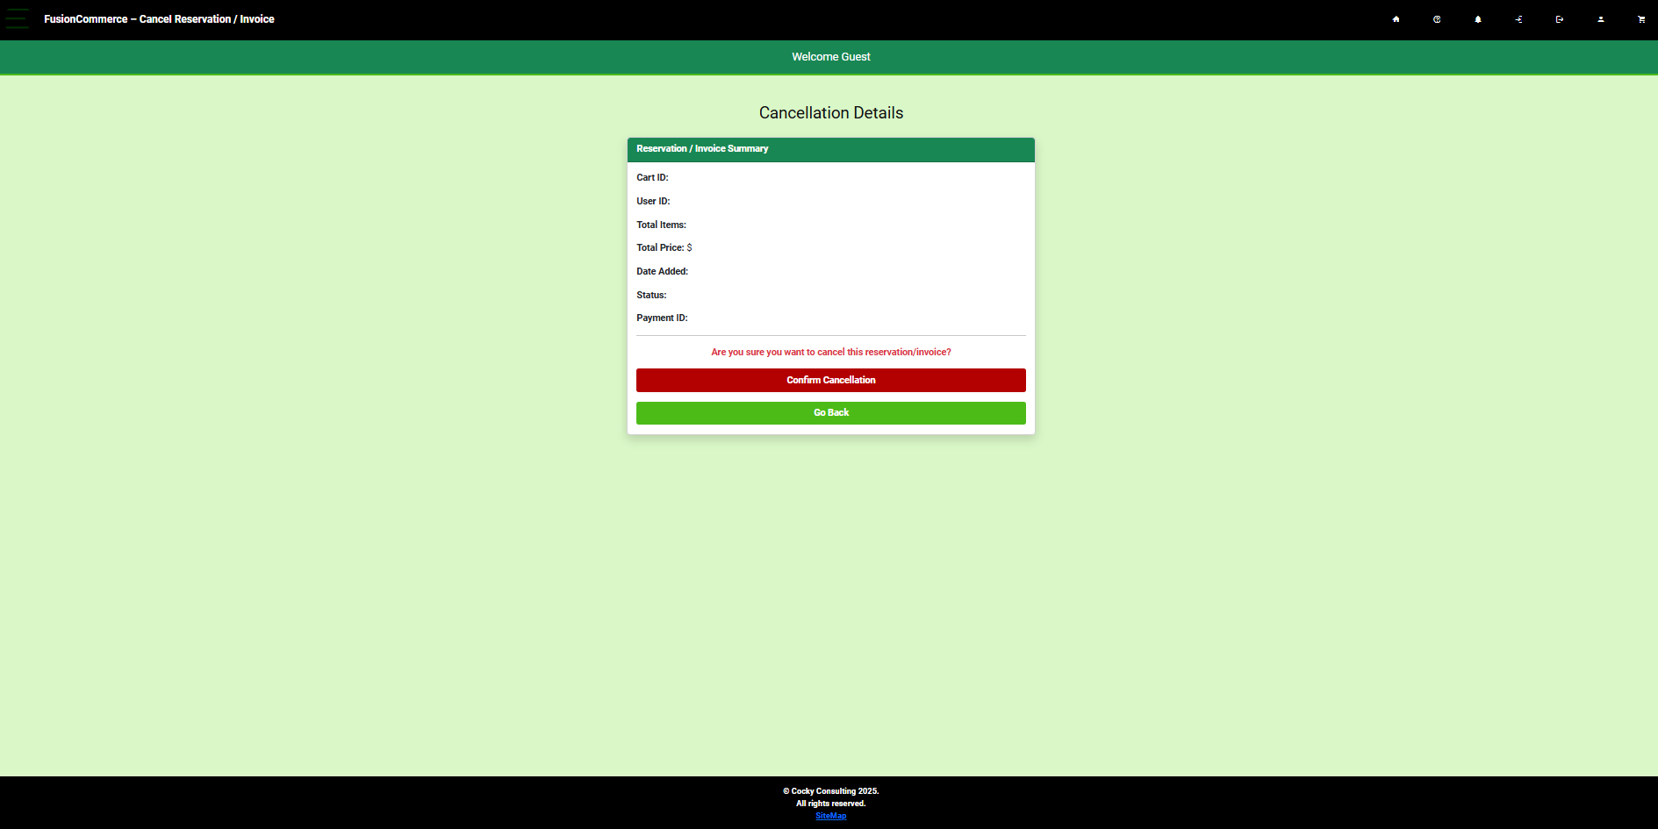
Other CART Pages
Paynow2.html -> After Payment – Different BackEnd – Working Partially.
Cartdetail.html shows a single transaction. Unchanged.
MyPurchases has replaced MyReservations It works the same more or less. But now supports invoices as well as reservations(more complicated)
CartCancel -> Cancels a Reservation and Reverses Charges to a Credit Card…

Slide 25
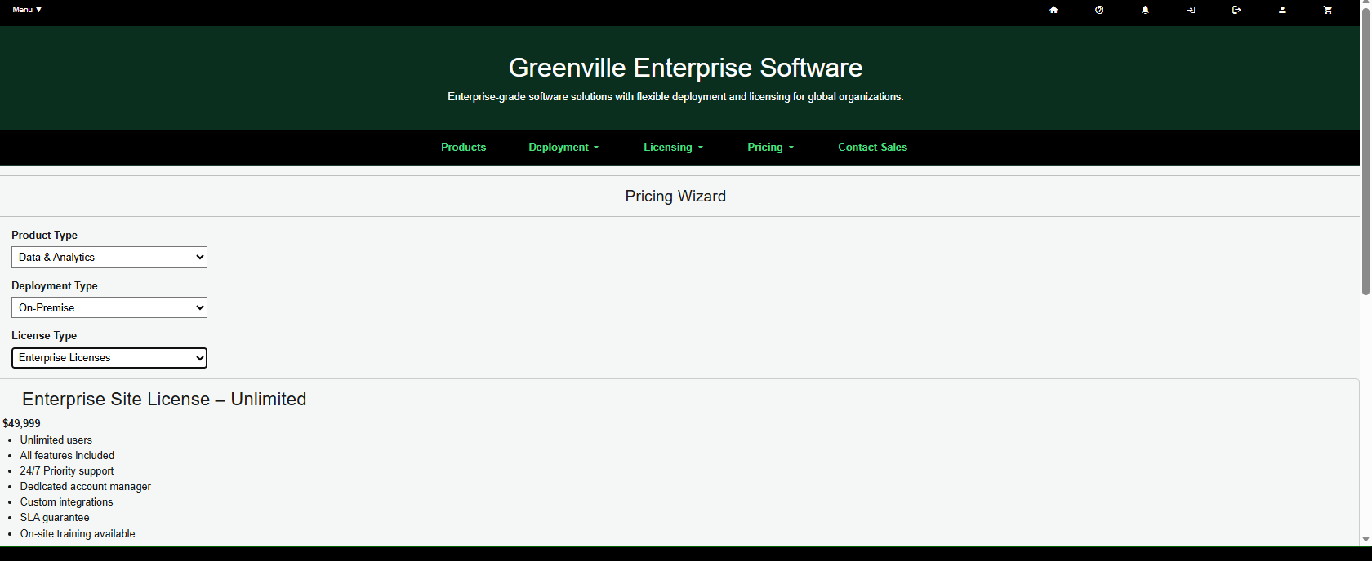
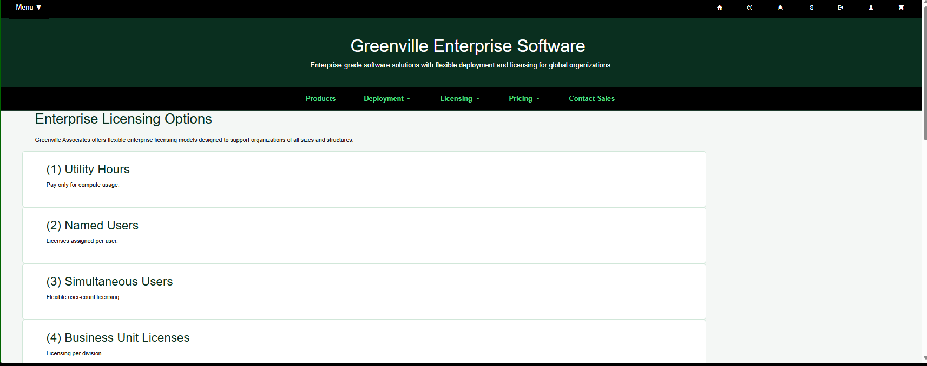
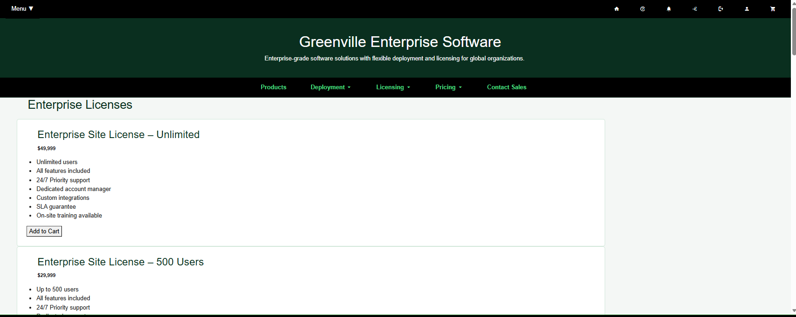
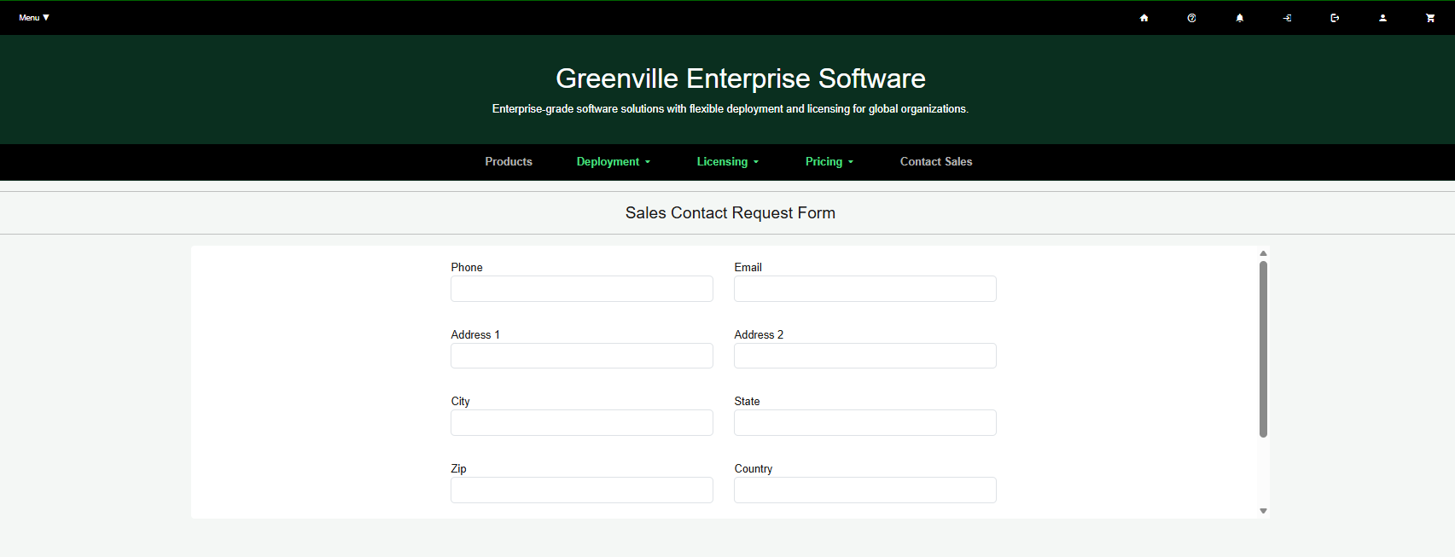
Pricing Wizard /Pricing Detail Pages
New License Page…. New Sales Contact

Slide 26
Pricing Wizard /Pricing Detail Pages
New License Page…. New Sales Contact

